Slide 1
The First World War
“The War to End All Wars”
Boys and Girls! War Savings Stamps Poster by James Montgomery Flagg 1917-18

Slide 2
The First World War:
What?
War involving nearly all the nations of the world
When?
1914-1918

Slide 3
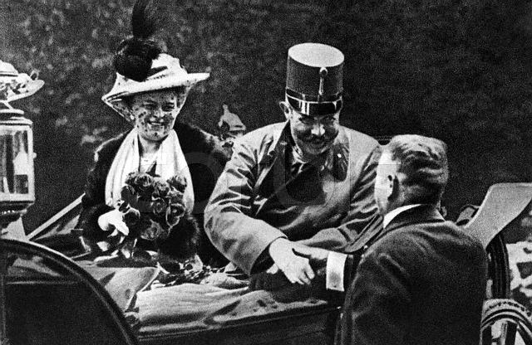
The First World War:
Long term -
1. Alliance system
2. Imperialist Competition
Stockpiling of Weapons
Extreme pride in nations, protecting power & land
Why?
Short term - Assassination of Franz Ferdinand of the Austro-Hungarian Empire
Franz Ferdinand, Archduke of Austria and his Wife Sophie, Duchess of Hohenberg one hour before their deaths, June 28, 1914

Slide 4
The First World War:
Who?
Central Powers:
Allies:
Germany
Austria-Hungary
Ottoman Empire
Bulgaria
Russia
France
Great Britain
Italy
Japan
United States (1917)

Slide 5
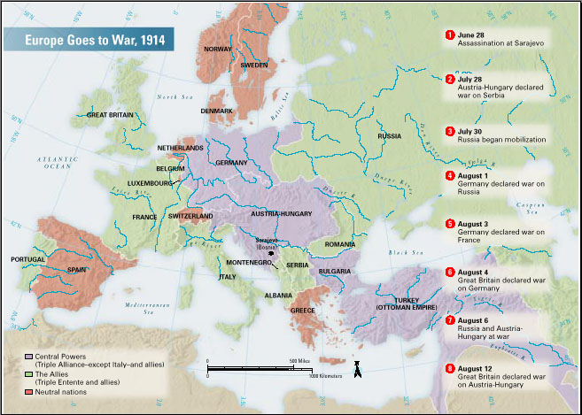
The First World War:
Where?

Slide 6
Why did it take so long for America to get involved in the war?
America was isolationist- Believed the war was a distant European matter
Fighting for land and influence
2 other sides formed as American opinions of the war grew
Interventionist- felt the war affected Americans and wanted to join on the side of the Allies
Internationalists- felt that America had a duty to be involved in world affairs, but wanted to promote peace and not join the fight

Slide 7
Thinking Slide:
Is isolationism really an option for a country as powerful as the United States?

Slide 8
Which side should the US pick?
Central Powers:
Allies:
11 million German-Americans
Irish-Americans hated Great Britain
Close cultural ties
Shared transatlantic cables (so censored stories)
Big business loaned much $ to allies
US Exports to both sides:

Slide 9
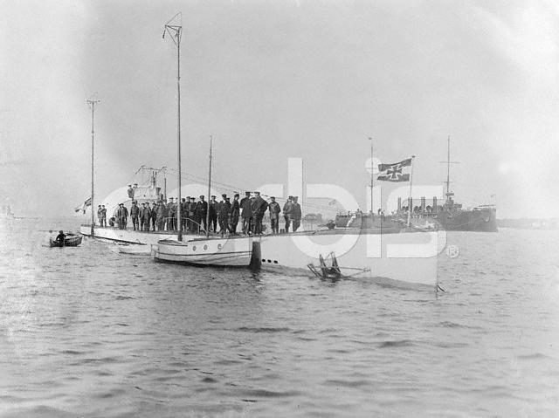
What did it take to get the US involved?
1. Blockades
Britain blockaded (stopped) all German ships going to America
Germany announced a submarine war around Britain
Y-53 German Submarine 1916

Slide 10
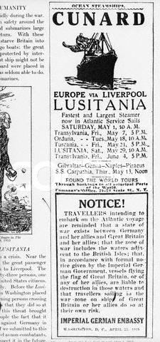
What did it take to get the US involved?
1. Blockades
In May, 1915 Germany told Americans to stay off of British ships
They could/would sink them

Slide 11
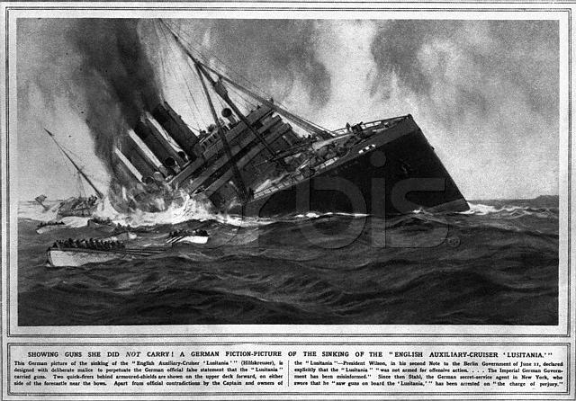
What did it take to get the US involved?
1. Blockades
Lusitania torpedoed, sinking with 1200 passengers and crew (including 128 Americans)
Was eventually found to be carrying 4200 cases of ammunition
German Propaganda Justifying Lusitania sinking

Slide 12
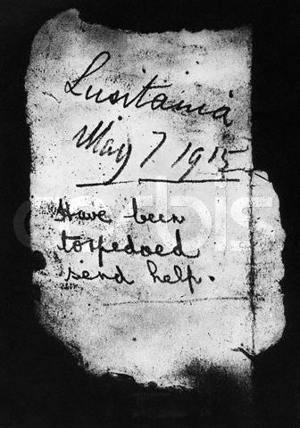
What did it take to get the US involved?
1. Blockades
The US sharply criticized Germany for their action
Germany agreed not to sink passenger ships without warning in the future
In 1916 they sank the French liner Sussex
Note in Bottle After Lusitania Disaster

Slide 13
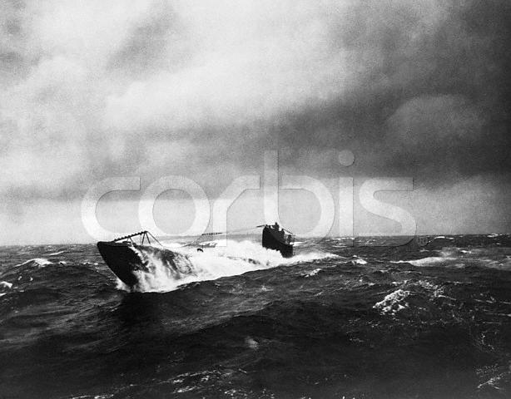
What did it take to get the US involved?
2. Unlimited Submarine Warfare
1917 Germany announced “unlimited submarine warfare” in the war zone
Why? Otherwise their blockade would not be successful

Slide 14
What did it take to get the US involved?
3. Zimmerman Note
US intercepted a note from Germany to Mexico,
It promised Texas, New Mexico, and Arizona back in return for an alliance
Germany was desperate for supplies and wanted an alliance with Mexico

Slide 15
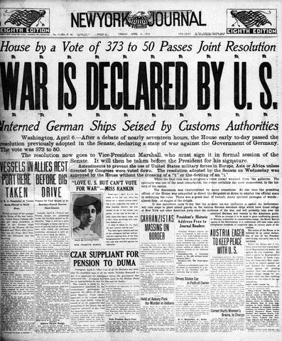
What did it take to get the US involved?
Zimmerman Note + the sinking of 4 unarmed American ships led to a declaration of war on April 2, 1917

Slide 16
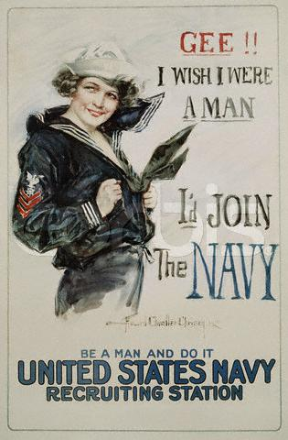
Convincing the American People
Posters - Gee!!
in 1916 prior to declaration of war Wilson began preparing for war
National Defense Act
Expanded the size of the military
Naval Construction Act
Built more war ships
1917 Selective Service Act
Authorized the draft

Slide 17
How did the War Affect the US?
Women
Women filled factory jobs
May have led 19th Amendment after the war (Gave women the right to vote)
African Americans
Black soldiers still served in Segregated Units
“Great Migration” - thousands of African Americans moved North to work in factories

Slide 18
How did the War Affect the US?
Enforcing Loyalty
Hatred of all things German
Ex. “Liberty Cabbage”
Espionage Act 1917 & Sedition Act of 1918 punished those against the war (many labor leaders)

