Slide 1
Woodrow Wilson & Peace

Slide 2
Wilson Works for Peace
Prior to US entrance into the war Wilson hoped for peace
“Only a tranquil Europe can be a stable Europe…There must be a peace without victory…Victory would mean peace forced upon the loser, a victor’s terms imposed upon the vanquished. It would be accepted in humiliation… and would leave a sting, a resentment, a bitter memory upon which terms of peace would rest, not permanently, but only as upon quicksand.”
-Woodrow Wilson, January 1917

Slide 3
14 points
One year after the peace without victory speech Wilson addressed Congress with a plan for peace
14 points
Asked for peace without vengeance
Laid out a plan for open diplomacy, free trade,
Wanted to end colonialism
League of Nations

Slide 4
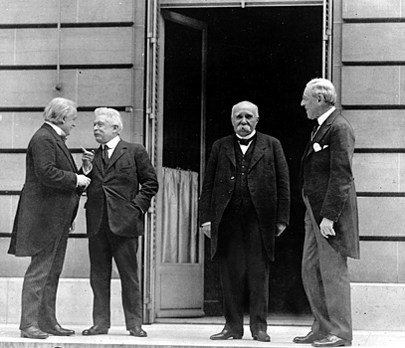
To The Victors Go the Spoils
Wilson did not trust other politicians to deliver his plans for peace, so he went to Europe himself
Europe blamed Germany for the damage and loss they had incurred and rejected Wilson’s plans for peace
They wanted reparation money
France wanted the return of Alsace-Lorraine
German colonies were targeted

Slide 5
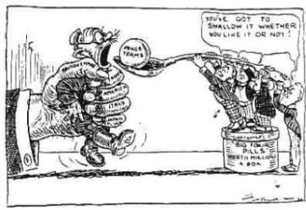
Treaty of Versailles
Territorial
Alsace-Lorraine (given to France)
Eupen and Malmedy (given to Belgium)
Northern Schleswig (given to Denmark)
Hultschin (given to Czechoslovakia)
West Prussia, Posen and Upper Silesia (given to Poland)
The League of Nations also took control of Germany's overseas colonies.
Germany had to return land taken from Russia. Some of this land was made into new states : Estonia, Lithuania and Latvia. An enlarged Poland also received some of this land.

Slide 6
Treaty of Versailles
Military
Germany’s army was reduced to 100,000 men; the army was not allowed tanks
She was not allowed an air force
She was allowed only 6 capital naval ships and no submarines
The west of the Rhineland and 50 kms east of the River Rhine was made into a demilitarized zone (DMZ).
No German soldier or weapon was allowed into this zone. The Allies were to keep an army of occupation on the west bank of the Rhine for 15 years.

Slide 7
Treaty of Versailles
German Guilt
Germany was forced to admit guilt for World War I
They were forced to pay reparation $ in which most money would go to France and Belgium for damage incurred during war

Slide 8
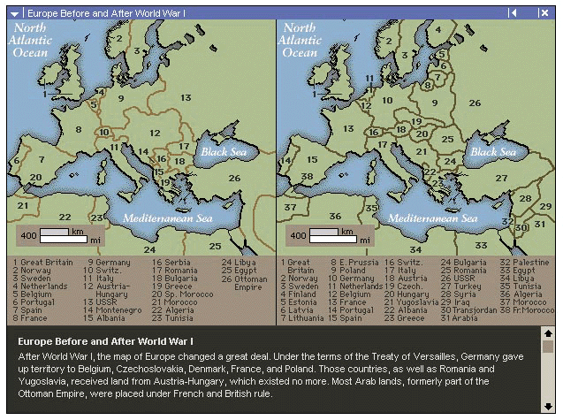
Other Treaties Create New Nations:

Slide 9
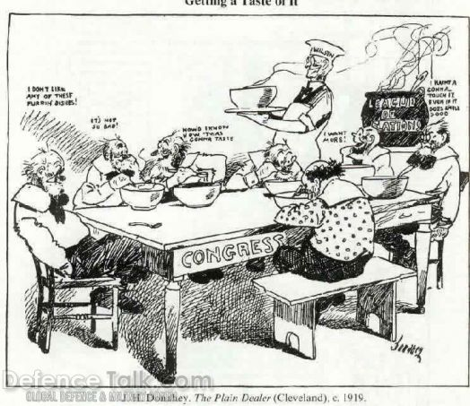
`America & the Treaty
Wilson returned home to present the treaty to Congress (then dominated by republicans)
Irreconcilables: Congressmen who were isolationists and did not want a treaty with a League of Nations
Reservationists: opposed the treaty as written wanted changes to be made

Slide 10
Rejection
In November 1919 The Senate voted on the treaty several times
Congress could not agree to the terms of the treaty and rejected it
America would not take part in the League of Nations

