Slide 1
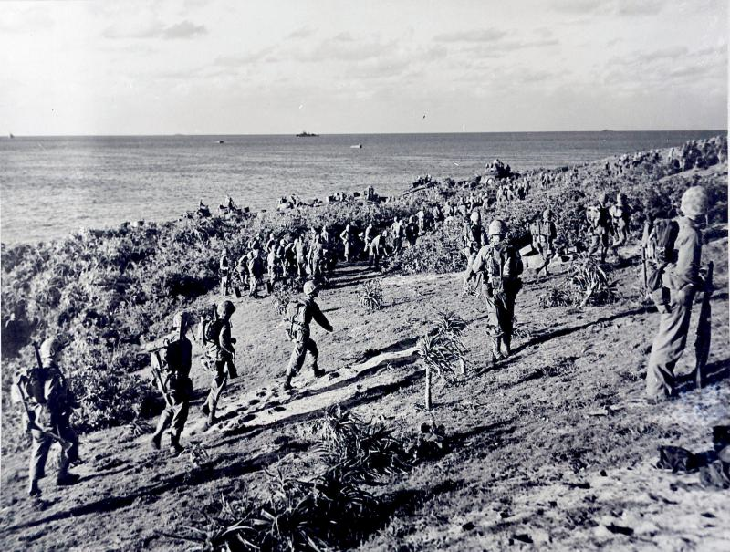
War in the Pacific

Slide 2
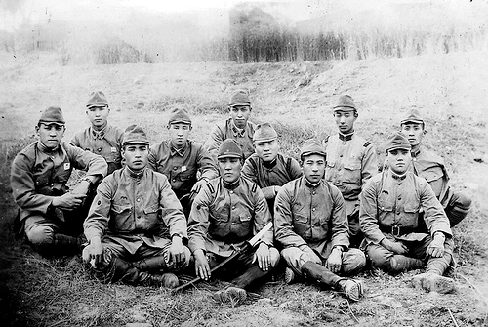
Japanese Offensive
Following Pearl Harbor the Japanese continued their expansion
In the spring of 1942 they took the Guam, Wake Island, Hong Kong, and the Philippines

Slide 3
Battle in the Philippines
General Douglas MacArthur led an attack against the Japanese in the Philippines in Late December 1941
Following brutal battles MacArthur was forced to retreat to Australia
Many Americans stayed behind suffering heavily from lack of supplies
In May 1942 75,000 Americans surrendered to the Japanese

Slide 4
Bataan Death March
The 75,000 Americans and allied Filipino troops were taken as Prisoners of War (POW)
They were forced to march 55 miles to the railroad where they were taken inland
After the train they marched 7 more miles to a prison camp
Over 7,000 men died during this forced march.

Slide 5
Doolittle Raid
April 1942 the United States returned a blow to Japan
Colonel James Doolittle led a team of 16 B-25 bombers on a night air raid of Japan
The raid killed 50 Japanese people and damaged over 100 buildings
This raid was minimal military gain for America, but lifted a lot of people’s sprits

Slide 6
Battle of Coral Sea
May 7 & 8 of 1942 the USS Lexington and USS Yorktown waged battle with the Japanese
This was the first naval battle where the war ships never sighted one another
The battle was done in the air
Fighters from each side attacked one another’s ships and dog fought in the air
The battle was a draw, but it did stop the Japanese attack on New Guinea

Slide 7
Battle for Midway
Admiral Yamamoto knew that Midway Island was vital for US navy to refuel and supply their ships in the Pacific
He planned to take the island and set up a Japanese presence in the Aleutian Islands in Alaska
June 4, 1942 Japanese launched their assault, but the US knew they were coming
Admiral Chester Nimitz had all the US aircraft carriers waiting
US sunk 4 Japanese carriers and 250 aircraft
America’s victory was the turning point in the war

Slide 8
Guadalcanal
August 1942 was the American’s first battle on the Offensive
American’s battled the Japanese for 3 months before pushing them off the island
They would use Guadalcanal as their first stepping stone to Mainland Japan

Slide 9
Island Hopping
The American’s used Island hopping as a strategy to win the war
They would hop to islands held by the Japanese and fight with them to gain control of the island
Each island would be used as a base to re-supply and inch troops closer to the mainland

Slide 10
Iwo Jima
February and March 1945 was the fiercest battle in the Pacific
36 days of fighting left over 23,000 US casualties
Japanese soldiers fought to the last man
Many Japanese soldiers committed suicide rather than being taken POW
Japanese pilots often would fly their planes into American ships (Kamikaze)

Slide 11
Okinawa
April 1945: was a vital battle for the Americans
Okinawa had a airbase in which the US needed to launch its campaign against the Japanese
½ million troops & 1,213 warships were used in the mission
50,000 soldiers were lost

Slide 12
Airstrikes
From Okinawa the US launched endless air attacks on Japan’s mainland
They targeted factories, military bases, and cities
The raids killed over 83,000 Japanese
In one raid alone over 16 miles of Tokyo was destroyed
The Japanese were short pilots, air planes, fuel and were unable to answer the attacks

Slide 13
The Atomic Bomb
In 1942 FDR made the decision to proceed with developing an Atomic Bomb
Over 7 billion dollars and 10,000 men were used to work on this project
The project was called the Manhattan Project and was led by General Leslie Groves, and Physicist J. Robert Oppenheimer
July 16, 1945 the bomb was tested
Oppenheimer said “ Now I have become death, the destroyer of worlds”
Groves said “ the war is over, 1 or 2 of these and Japan is through.”

Slide 14
Hiroshima and Nagasaki
August 6, 1945 the United States dropped an Atomic bomb on Hiroshima
60,000 of the 344,00 died in the attack
Following the attacks the Japanese government debated surrender
Before they could surrender the Soviet Union declared war on Japan and invaded Manchuria
United States dropped a second bomb on Nagasaki the same day killing 35,000

Slide 15
V-J Day
Emperor Hirohito decided to surrender following the bombings of Nagasaki and the declaration of war by the Soviets
American’s celebrated victory over Japan on August 15
The formal surrender of the war was on September 2, 1945
Japan Surrendered to General MacArthur aboard the USS Missouri

