Slide 1
Vietnam: Start to End

Slide 2
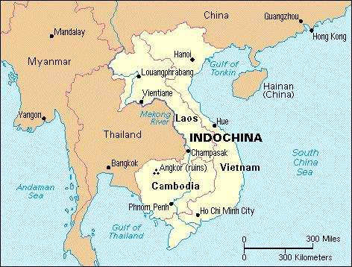
French Colonialism
During the 1800’s France colonized Vietnam, Cambodia, and Laos
France ruled Indochina with an Iron fist
  French laws, taxes
  France also controlled the natural resources of the area
Ho Chi Minh, an avid protester of French rule fled Vietnam to gain supporters to fight the French

Slide 3
Vietnam & Communism
During WWII Japan had taken Vietnam from the French
  Following the War France tried to reestablish its colony
Ho Chi Minh gained backing from Soviet Union and encourage communist principals throughout Vietnam
The United States backed France’s efforts despite being ant colonialist, because of their Cold War dispute with USSR

Slide 4
France Looses IndoChina
In May 1954 the French lost their battle against the Vietminh at Dien Bien Phu.
  55 day battle
  France lost 15,000
Following Dien Bien Phu France sued for Peace in Geneva, Switzerland
  France gave up claims to Vietnam, Cambodia, Laos
  Divided Vietnam at the 17th parallel until 1956 where reunification elections could be held
    North Vietnam –Communist
    South Vietnam- anti-communist

Slide 5
America Contains Communism
Starting with President Truman the US contributed $2.6 billion to help French forces battle communists in Vietnam
United States continued to fund South Vietnam and it’s leader Ngo Dinh Diem following the division

Slide 6
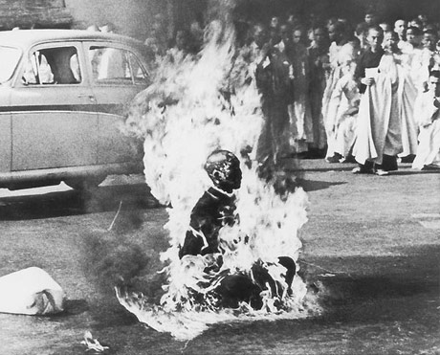
1956 Reunification Elections
Poll’s predicted Ho Chi Minh the victor of the 1956 elections, so Diem refused to participate
Pro communist groups such as the Vietcong formed in the south to oust Diem from power
  Assassinated government officials
  Destroyed roads and bridges
Diem was unpopular based on his religion and legislation he backed, US support was the only thing keeping him in power

Slide 7
Kennedy Sends in Troops
In 1961 President Kennedy sent Special Forces troops to help advise South Vietnam Army
  15,000 advisors were fighting by 1963
Diem continued to cripple his platform with laws and actions
  The US plotted his overthrow with Anti-Diem Generals
  November 1, 1963 Diem was removed from power and later assassinated

Slide 8
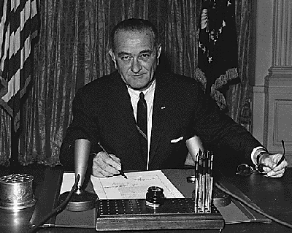
The Gulf of Tonkin Resolution
In 1964 the USS Maddox was attacked by North Vietnam torpedoes
President Johnson viewed this as an act of aggression and asked congress to allow force to protect troops
Congress passed the Gulf of Tonkin Resolution
  Gave Johnson Power to commit troops to South Vietnam
  Also allowed all necessary measures to repel armed attacks against US Forces

Slide 9
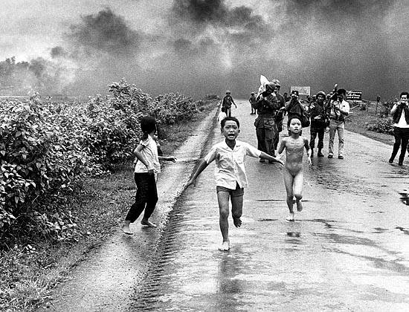
Operation Rolling Thunder
In 1965 President Johnson ordered a massive bombing strike on North Vietnam following Vietcong attacks on Americans
Johnson also increased the number of troops on the ground
  Soldiers left their adviser roles and took on combatant jobs
From 1965-1975 the US dropped over 6 million tons of bombs, Napalm, and Agent Orange

Slide 10
Guerilla Warfare
Ho Chi Minh operated on a policy that if victory is not ensured do not fight
His troops would travel light, and attack in small groups during the night
He believed that US forces could be worn down over time and they would eventually leave
Vietcong infiltrated US Bases and set off explosives, they would booby trap the ground

Slide 11
Doubt in America
By 1968 there was nearly 1 million US soldiers on the ground and nearly 30,000 casualties
Most soldiers had been drafted, and served their country bravely
  However many began to question why our troops were dying for a people that were not willing to protect themselves
The war and Johnson’s Great Society Plan strained the economy and led Congress to split the nation over the war
  Hawks- supported the war and Communist containment
  Doves- questioned the war and its politics

Slide 12
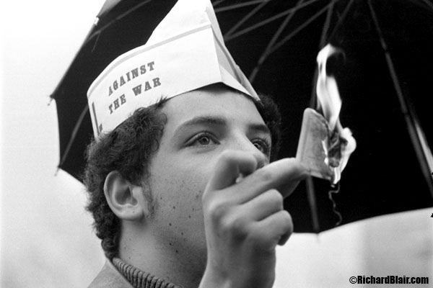
The Draft
By 1965 most troops were drafted
The Selective Service Act of 1948
  Required all males to register at 18
Many people were critical of the Selective Service System
  Local draft boards could pick men to go
  Deferments could be obtained by going to college
  Most men that went were from poor working class families
  20% of casualties were African American Men
In 1969 a draft lottery system was put in place to eliminate inequalities

Slide 13
Students Protest
Students at Universities across the country spoke out against the war
  Its effects on the economy
  The draft
  The foreign politics
Students at University of California Berkeley & University of Michigan formed Students for a Democratic Society (SDS) to speak out against the war
  Led teach-ins about the war
  Formed freedom of Speech movements when suppressed by colleges or police

Slide 14
The First Television War
Vietnam was the first war Americans could follow on the TV
Every night American’s tuned into local news to track the progress of the war
Many were disheartened when they realized there was no march to victory
In 1967 General Westmorelad assured the public that the Vietcong were loosing power, and would soon be defeated

Slide 15
Tet Offensive
Early 1968 the Communist went on the offensive
  Coordinated assaults on 38 provincial capitols
  5 major cities
  U.S embassy in Saigon
Communists planned to hold these positions until the cities sided w/ them
Following the Tet Offensive Johnson asked Secretary of Defense Clark Clifford to re-evaluate the war effort
  Clifford determined the war would be too costly on many fronts and we should negotiate peace

Slide 16
1968 Election
President Johnson addressed the nation 2 months following the Tet offensive
  Said the US would seek peace in Vietnam
  Johnson also stated he would not run for President in 1968
Robert F. Kennedy announced his campaign for presidency, but was assassinated
The Election came down to
  Richard Nixon- 301 electoral 31,710,470 popular
  Hubert Humphrey- 191 electoral 30,898,055 pop
  George C. Wallace- 46 electoral 9,906,473

Slide 17
Nixon’s Vietnam Peace talks
Nixon entered office with the goal of ending the war peacefully and honorably
  Americans and South Vietnam wanted communist troops out of South Vietnam & return of POW
  North Vietnam wanted American withdraw from Vietnam and a coalition government in South Vietnam including Vietcong representatives
North Vietnam refused the terms, believing they could win in battle
South Vietnam refused terms, believing their security was at risk

Slide 18
Vietnamization
Nixon refused terms of peace as well
  He began slowly pulling American troops out of Vietnam
  Believed South Vietnam should assume the war burden
    Thought with US aid their army could fight its own battles
Nixon ordered a secret bombing of the Ho Chi Minh Trail in Cambodia
  Widened the scope of the war and hurt relations with neutral Cambodia
Vietnamizaton nor bombings helped South Vietnam to victory

Slide 19
Cambodia
Nixon was distressed at how slow Peace talks were going in the war
In April 1970 He addressed the nation about military action in Cambodia
  Wanted to attack Vietcong bases and North Vietnam armies in Cambodia
  Also wanted to fight the Khmer Rouge ( a communist movement growing in Cambodia)

Slide 20
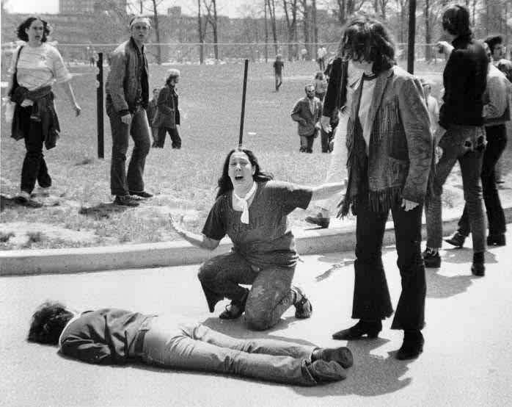
Discontent at home
Military assaults on Cambodia led to protests and riots at home
  College campuses exploded with protests
  Police and National Guard were sent in to keep order
Kent State
  Students threw rocks and bottles at National Guards members
  One soldier fired his weapon, leading others to do the same. 4 students were killed
Jackson State University
  Students and Police clashed leaving 2 students dead

Slide 21
Counter Protests
Many Americans believed in the US war effort and launched counter protests movements
New York City May 1970
  Construction workers marched through the streets shouting “All the way USA”
  Believing anti-war protesters had spit on the flag a fight broke out
  Days later another march went on in support of Nixon: Businessmen, housewives, secretaries, construction workers etc

Slide 22
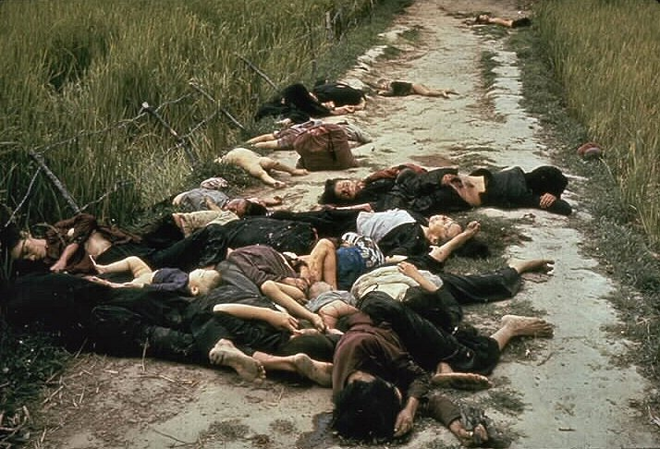
My Lai
In 1971 news of a military massacre of unarmed civilians in South Vietnam came to light
  In 1968 US soldiers looking for vietcong troops slaughtered men, women, and children in My Lai
  During the investigation the leader of the unit Lt. Calley claimed he was just following orders
  He was later convicted and jailed

Slide 23
The War ends
In 1971 a public opinion poll showed that 2/3 or American’s wanted to withdraw from the war
  Congress pushed Nixon to bring the troops home
October 1972 US and North Vietnam came to a peace agreement
  Nixon won re-election because of this
The peace agreement fell apart when North Vietnam backed out of signing the agreement
    Nixon renewed bombing efforts until North Vietnam agreed to terms

Slide 24
Paris Peace Accords
In January 1973 The US, North Vietnam and South Vietnam met in Paris to sign the terms of peace
  Cease fire
  Return of POW
  North Vietnamese troops remain in South Vietnam
  National Liberation Front (Vietcong) would become a political party in South Vietnam
  South Vietnam would keep non communist government
  Us Troops would come home

Slide 25
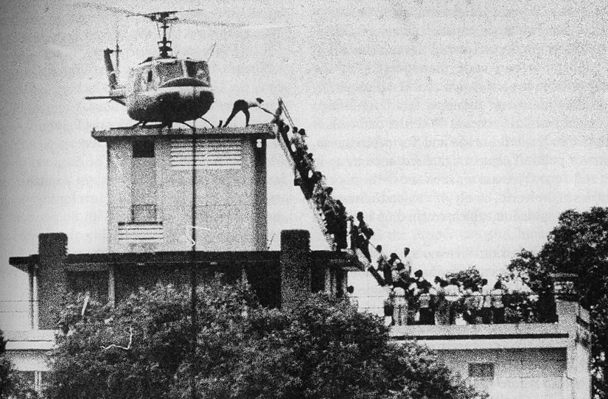
Fall of Saigon
As the US troops were heading home War still waged in Vietnam
Neither the South or North Vietnamese honored the Paris Peace Accords
  In the Spring of 1975 the North Vietnamese launched an attack on Saigon
  The South Vietnamese was no match for the North without the US and fell
  After years of fighting Vietnam was unified under one government one flag

Slide 26
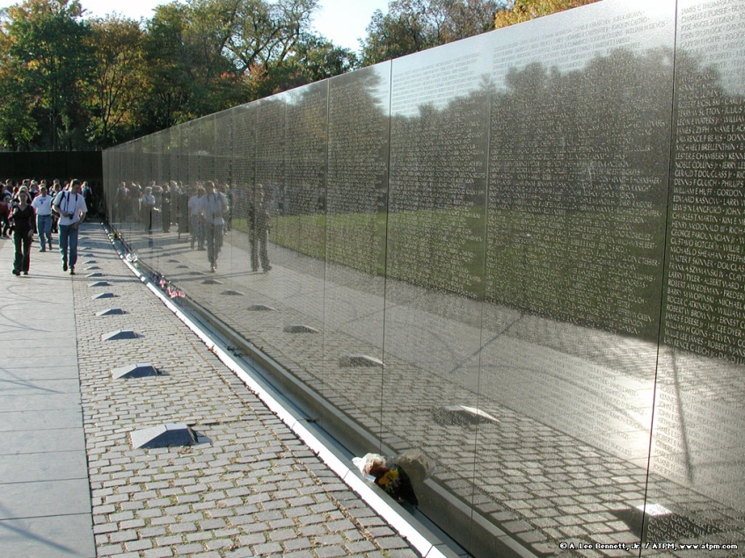
Impact of Vietnam
58,000 US soldiers died
300,000 wounded
Over 2 million Vietnamese estimated killed
Communism spread throughout South East Asia
  Cambodia fell to the Khmer Rouge, and began a genocide killing 2 million

Slide 27
Impact on American Politics
The war impacted domestic policies at home
  Taking from schools, and health care to buy guns and bombs left people untrusting of presidents
In 1973 Congress passed the War Powers Act
  Restricting President’s war making powers
  President had to meet with congress 48hrs prior to committing troops to foreign conflicts

