Slide 1
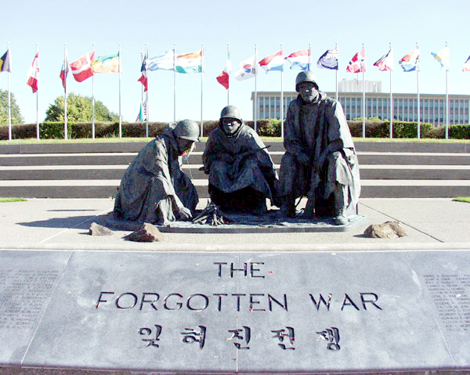
The Korean “Conflict”

Slide 2
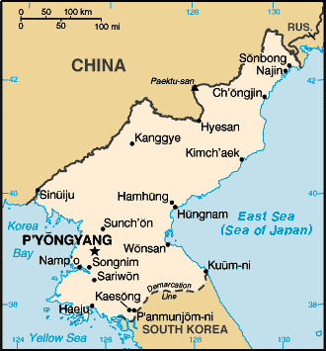
Korea after WWII
During WWII Korea had been occupied by Japanese forces
Once the war was over Soviet Union and United States split the country into two new countries at the 38th Parallel
North Korea- Communist
South Korea- non-Communist

Slide 3
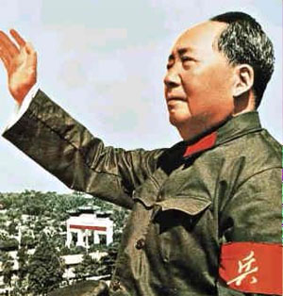
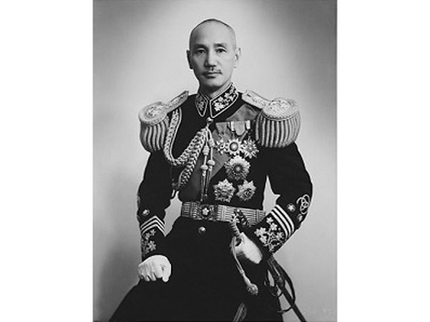
China
Prior to WWII China was in a bitter Civil war
Nationalist leader Jiang Jieshi
Communist leader Mao Zedong
During WWII they set their differences aside to battle the Japanese
Following the war they resumed their fighting
Soviet Union provided aid to Mao
United States sent billions to Jiang

Slide 4
Communist China
Jiang and his generals were corrupt
Using US aid money to line their own pockets
Chinese civilians were starving due to lack of food and supplies
Mao promised to feed the people in return for their support
Mao was victorious in China and Communism took over
Jiang escaped to Taiwain

Slide 5
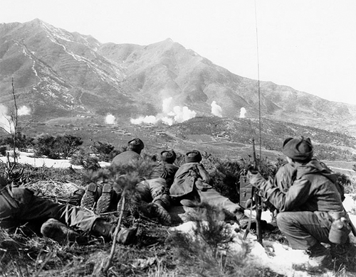
North Korea Invades the South
In June 1949 American troops left South Korea coinciding with China loosing to the Communists.
In June of 1950 North Korea invaded South Korea, taking their capitol city within days

Slide 6
US Reaction
Truman did not want to appease the North Korean’s so he immediately announced the US would aid the South Koreans
The UN Security Council voted unanimously to follow the US’s lead
There was not a formal declaration of war, but Truman supported the UN resolution and ordered troops to South Korea

Slide 7
US Forces on the Ground
Troops under the command of General Douglas MacArthur left Japan to meet up with South Korean Allies
Troops were not prepared to fight in Monsoon, tropical conditions
Soon were retreating alongside South Korean troops
While recovering from the retreat US and South Korean forces were joined by soldiers from countries belonging to the UN.

Slide 8
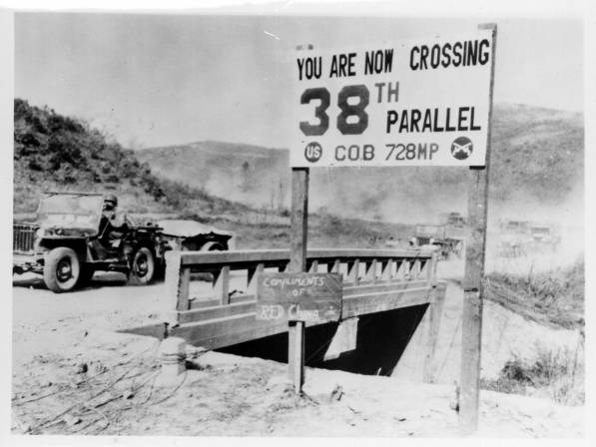
MacArthur Strikes Back
By September 1950 troops were trained and re-supplied
MacArthur figured North Korea had limited supply lines due to their rapid attacks
MacArthur planed a surprise attack at Inchon, behind enemy lines
The attack at Inchon was so successful North Korean troops retreated north of the 38th Parallel

Slide 9
China Interferes
The United States the pushed a resolution through UN to support a Unified, Independent, Democratic Korea.
China warned the US not to advance near its boarders
MacArthur assured Truman the Chinese would not make good on their warnings
Truman allowed MacArthur to advance into North Korea
By November 1950 the US had reached the Chinese Border, and 300,000 Chinese troops attacked South Korean and US positions.

Slide 10
Truman vs. MacArthur
Following the invasion of China, the war became more complicated
MacArthur knew the battle could not be won without a larger commitment of troops and possibly atomic weapons
Truman refused both
MacArthur was outraged at Truman’s use of limited war and wrote to House Republican leaders attacking the President
Truman fired MacArthur for insubordination
Upon MacArthur’s return home he was welcomed as a National Hero

Slide 11
Stalemate
The battles continued to be bloody and ruthless, but produced little results
The war had stalled at the original 38th parallel
During the Presidential election of 1952 Eisenhower promised to end the war if elected
Upon victory Eisenhower visited Korea and inspected troops and hinted at more aggressive efforts to the opposing side.

Slide 12
Settling the Conflict
In 1953 the world had tired of the conflict and the fear of nuclear weapons had led to more successful peace talks
Joseph Stalin had died
After 3 years of fighting a cease fire was signed in July 1953.

Slide 13
Effects of the War
Immediate Effects | Long Term Effects
37,000 Americans Killed | Military spending increased
103,000 Americans wounded | Military commitments increase worldwide
Relations with China Worsen | Relations with Japan Improve
Armed Forces racially integrated | Future Presidents send military into combat without Congressional approval
There was no victory in Korea
North Korea remained Communist and loyal to China and Soviet Union, South Korea remained noncommunist and loyal to the US
The Southeast Asia Treaty Organization was created to prevent the spread of Communism throughout the rest of Asia
Members were Pakistan, Thailand, Philippines, Australia, New Zealand, France, Britain, and the US

