Slide 1
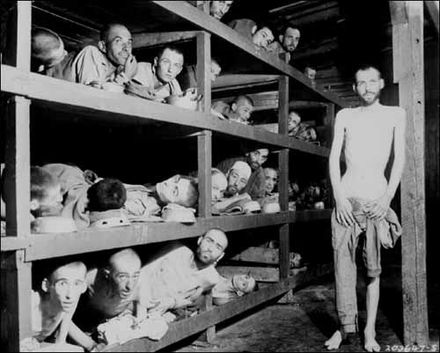
The Holocaust

Slide 2
The Early Stages
During his rise to power Adolf Hitler blamed Jewish peoples for the problems of Germany
He wrote of his distaste of Jews in his book Mein Kampf
In 1933 when he became Chancellor of Germany he encouraged Germans to boycott Jewish business
Barred Jews from civil service jobs, banking, stock exchange, law, and medical practice

Slide 3
The Nuremberg Laws
Hitler enacted a list of laws in 1935 targeting Jews
Denied German citizenship to Jews
Banned marriage between Jews and non Jews
Segregated Jews from society
He used the press to spread his message
Newspapers printed scandalous messages
School children were taught Jews were “polluting” society
Comic books were designed to picture Jews as bad people.

Slide 4
Kristallnacht
November 9, 1938:
Jewish refugee killed a German diplomat in Paris
Nazi officials ordered attacks on Jews in Germany, Austria, and the Sudetenland
Secret Police and military destroyed 1,500 synagogues, 7,500 businesses, killed 200 Jews, injured 600 more, and thousands were arrested

Slide 5
Refugees
Between 1933 and 1937 about 129,000 Jews left Germany and Austria
Albert Einstein and other great minds of the time were part of the rush to leave
More Jews would have left during this time, but were not being accepted by other countries
St. Louis left Germany with 900 Jews aboard, but 878 of them were turned away in Cuba, and the US would not accept them either, they were returned to Germany (600 of them later died in camps)

Slide 6
Concentration Camps
1933, Hitler opened the first Nazi run concentration camp
Initially intended not to kill prisoners, but to make them work for the Reich
Early camps were Dachau, Sachsenhausen, and Buchenwald, and Ravensbruck
The people imprisoned were political rivals, or people deemed inferior to the Nazi Party
Communists, socialists, labor leaders, priests, Jews, Gypsies, homosexuals, Jehovah's witnesses, beggars, drunks, physically and mentally disabled

Slide 7
Camp Set-up
Prisoners were branded with tattoos upon entry into the camp
They wore stripped uniforms with triangle symbols on them
Yellow for Jews
Pink for Homosexuals
Red for political prisoners
Purple for Jehovah witness

Slide 8
Treatment
Camp Guards were not restrained
They could torture or kill prisoners without fear of punishment
Death by starvation or disease was common
Experiments were performed on many prisoners ( oxygen deprivation, hypothermia, altitude effects )
Over 5,000 mentally handicapped children were the subject of this abuse

Slide 9
Wannsee Conference
In January 1942 the Nazi Party met at the Wannsee Conference
They discussed moving toward the “Final Solution”
Reinhard Heydrich developed the plan to execute the Jews
Many camps became designated death camps (mostly Polish camps)
Auschwitz, Treblinka, Maidenek, Sobibor, Belsec, Chelmno

Slide 10
The Final Solution
Some death camps used gas chambers
Prisoners would be forced into sealed rooms and carbon monoxide or insecticide would pump into the room killing hundreds per day
Camps without gas chambers would shoot hundreds of thousands of prisoners, many Jews were killed during raids of towns and buried in mass graves
Fully functioning death camps would use the human fat for soap, hair for wigs, they would dig gold fillings from teeth, and take wedding rings, the bodies would be burned in crematoriums

Slide 11
The Numbers
By 1945 about 6 million European Jews had been systematically murdered
5 million non-Jews were also killed

Slide 12
Foreign Response
Many blame the US, Britain, and France for not relaxing immigration policies and helping European Jews
Troubled by Great Depression, Anti-semetic views, and underestimation of Hitler
By 1942 word of the killings was received by the Allies, but no action was taken
All resources were aimed at defeating Hitler not stopping the genocide
In 1944 FDR established a War Refugee Board
Worked with the Red Cross to rescue Jews

Slide 13
Liberation of the Camps
American troops began liberating camps as they took control of German held lands
They found piles of dead bodies, warehouses of human hair, jewelry, ashes, emaciated survivors
“The memory of starved, dazed men, who dropped their eyes and heads when we looked at them through the chain-link fence, in the same manner that a beaten, mistreated dog would cringe, leaves feelings that cannot be described and will never be forgotten. The impact of seeing those people behind that fence left me saying, only to myself “now I know why I’m here.”
- Richard Winters

