Slide 1
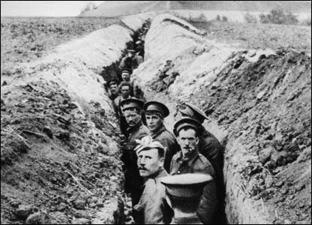
Technology and War

Slide 2
America Joins the War
General John J. Pershing arrived in France in June 1917
Small forces of men arrived throughout 1917
Larger groups arrived in early 1918
American troops (doughboys) fought bravely at some of the wars most brutal battles
2nd battle of the Marne
Bellau Wood
Chateau-Thierry

Slide 3
Casualties
American causalities were smaller due to late entry into the war
Americans lost 50,000 and had over 230,000 wounded
1.3 million served during the war

Slide 4
War Tactics
Trench warfare became a trademark war tactic of WWI
450 miles of trenches were dug from Belgium to the border of Switzerland
Life in the trenches
Rat infested
Dirty (especially in rainy seasons)
Dead bodies often littered the trenches along with trash and human waste.

Slide 5
No Man’s Land
The area of ground separating each side from their enemies trench
The area was often riddled with land mines and barbed wire
Going over the top:
When men would go out of the trench into no man’s land attempting to take their enemies trench.

Slide 6
New Technology
Machine guns:
New machine guns could fire over 600 bullets per minute
Artillery:
Long range canons could affectively kill at longer distances causing more death than any other weapons in the war
Rifles
Rifles were more accurate at longer distances and could hold more ammunition

Slide 7
Gas
“The special shells the men call “shells on wheels” (shells filled with poison gas) are whizzing by continuously. They explode silently and have no smell but can be deadly. They killed several men yesterday. One of my men refused to put his mask on because he couldn't smell anything. All of a sudden, he was dizzy, foaming at the mouth and his skin went black , then he went rigid and died.”
-Paul Truffaut, march 5, 1917
Modern chemical warfare was first introduced in WWI
Gas invoked terror throughout the trenches
Gas masks were provided to the men on the front lines
Chlorine, phosgene, and mustard gas were used by both sides
Could kill, blind, burn victims

Slide 8
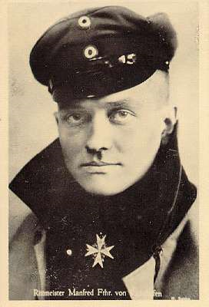
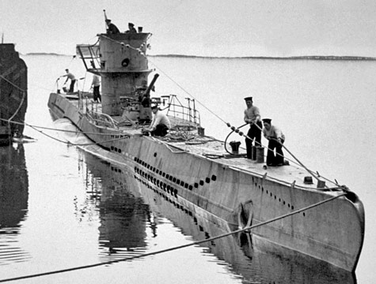
Planes, Tanks, & Boats
German U-Boats wreaked havoc on the Allied forces with their submarine warfare
They sunk supply ships faster than they could be re-built
This led the Allied forces to move supplies in convoys
Tanks and armored cars were built to go over rough roads and barbed wire
These vehicles did not see success until WWII
Airplanes were used for reconnaissance, bombing, and fighting but did not meet their true potential until WWII

Slide 9
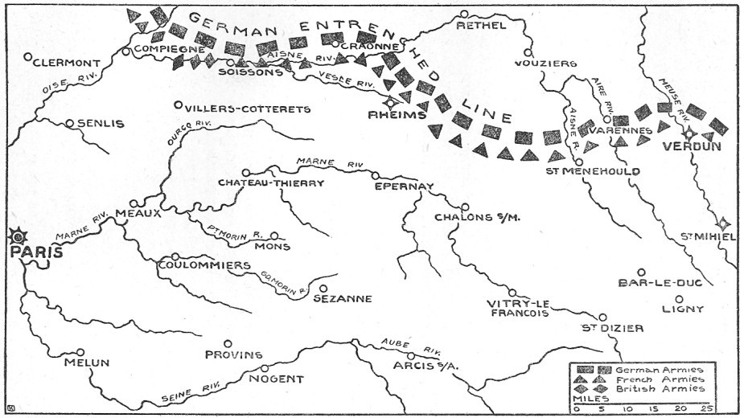
Stalemate
The war was a constant stalemate until 1918
Each side had equally advanced weaponry which allowed them to remain in the fight
Trench warfare allowed for limited advancement keeping soldiers in trenches for years
High casualties on both sides were common
United States entry allowed for revitalizing the Allied war effort and bringing victory

Slide 10
The War Ends
By fall of 1918 the German front had collapsed
Men from German and Austrian-Hungarian armies disserted, refused to fight, or mutinied.
November 11, 1918 Germany surrendered

