Slide 1
Post War Society

Slide 2
What to do with the Soldiers
During WWII 12 million Americans served in the Armed forces
By July 1946 only 3 million were still active in the military
Many American’s believed that the end of the war would renew the Great Depression
To prevent America’s fears from coming true Congress passed the GI Bill of Rights

Slide 3
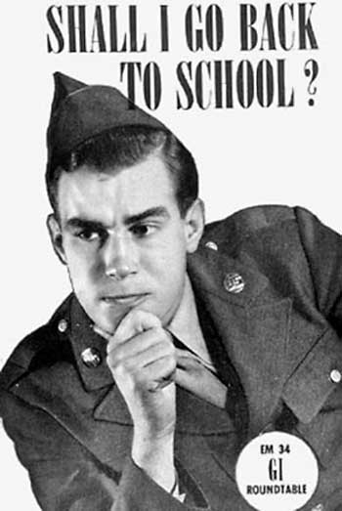
GI Bill of Rights
The GI Bill of Rights provided a variety of benefits for men returning home from war
One year unemployment for those who could not find work
Financial aid for those who wanted to attend college
Government loans to build or buy a house or start a business
The GI bill had an enormous impact on society
Suburban neighborhoods boomed
Over 8 million veterans took advantage of higher education

Slide 4
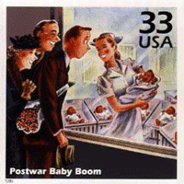
Baby Boom
When soldiers returned home from the war they quickly married and began families
It was estimated in 1957 that one American baby was born every 7 seconds (4.3 million babies that year)

Slide 5
Economic Boom
At the end of WWII the US was one of few nations unscathed by the massive devastation of the war
The US was responsible for producing 50% of the world’s output in manufactured goods
This allowed a higher standard of living for Americans
The use of new technologies such as computers were beginning to help America grow and modernize
The outbreak of the Korean war also aided the economy and sciences
Plastics and light alloy metals were produced during this era

Slide 6
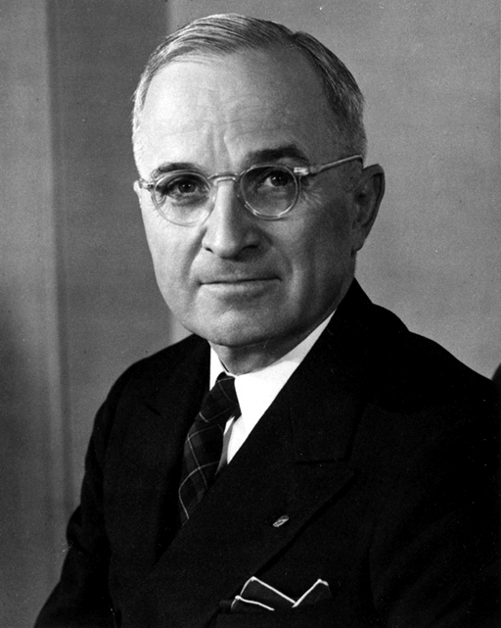
Truman
Truman had only been Vice-President for 4 months when FDR died
Upon taking office he implemented many new landmark ideas and laws
Desegregated the military
Pushed for a committee to investigate civil rights
Fair Deal
Pushed for reform of many New Deal programs including health insurance (Congress did not budge)

Slide 7
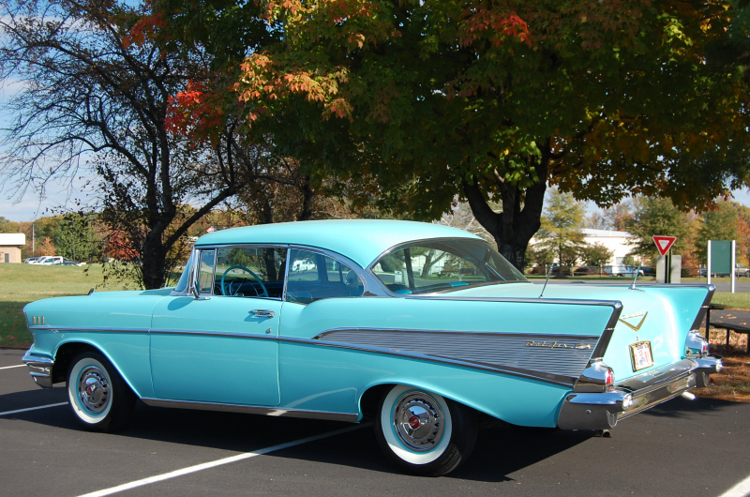
America and Cars
Between 1940-1960 more than 40 million Americans moved to the suburbs
Urban housing was not available in the numbers needed
Wanted a place to call their own
For transportation to go too and from the cities from work the car ownership jumped
From 26 million in 1945 to 60 million in 1960

Slide 8
Eisenhower Interstate Highway System
First funded in 1953
Congress authorized the building of 41,000 miles of highway
These highways were multilane expressways that connected the nations cities
Besides easing commutes the highways also boosted vacation and tourism
Many businesses opened fast food restaurants, service stations, motels, amusement parks (Disney World)

Slide 9
Sunbelt Migration
During the post-war era many people began migrating to the “sunbelt”
These areas were typically southern or western states
Areas such as Houston, TX or Los Angels, CA were attractive due to the weather and large defense contracts offering work

Slide 10
Economy Changes Focus
White collar jobs began to grow due to the need for information industries
Working with computers and office atmospheres
Blue collar jobs declined due to the increase in technology
Mechanical cotton pickers, chemical pesticides, and new irrigation systems
Francise businesses began opening up across the country
Holiday Inn grew up during this time
Multinational companies also developed during this time (IBM, General Motors, General Electric)

Slide 11
Education Grows
In 1940 only 15% of college age kids attended university
By 1960 close to 40% entered college
Local and state governments poured money into opening new schools to service the baby boomer generation
National Defense programs allowed $1 billion for children willing to study science, math, and aerospace

Slide 12
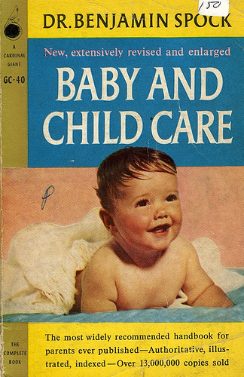
Family Life
Following WWII many women returned home to tend the house and children
Social Scientists and the media encouraged women that it was their duty to be at home
“A woman is not a woman unless she has been married and has had children”
Children were also the main focus of family life was children
Dr. Spock was a household name giving expert advice on rearing your children.

Slide 13
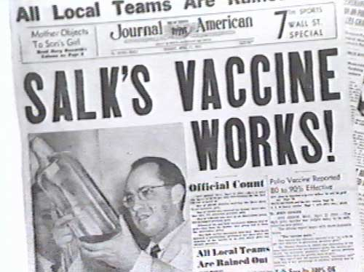
Health and Wellness
The most revolutionary health care advance was the Salk Vaccine that prevented Polio
Antibiotics and penicillin started being used widespread
Combated whooping cough, TB, strep throat and more.

Slide 14
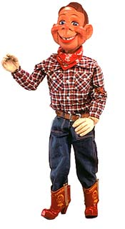
TV
TV was extremely popular and targeted children
Howdy Doody, Mickey Mouse Club, Lone Ranger
Popular TV shows for the whole family also were popular, they reflected the social culture of the day (no divorce, drug and alcohol use, mental illness never appeared on shows)
Leave it to Beaver, I Love Lucy, Honeymooners

Slide 15
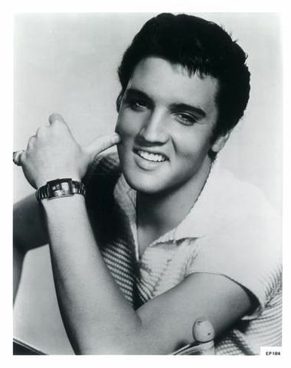
Music
In 1951 DJ Alan Freed filled the airways with Rock-N-Roll
Rock-N-Roll was first considered Race music but with radio putting it across the airways it picked up
Elvis Presley made it a house hold name selling millions of singles
When Elvis appeared on the Tonight Show the cameramen were only allowed to film him from the waist up because his dancing was considered too racy for TV

Slide 16
The Strife of the 50’s
Beyond new cars and houses were the poor and socially rejected
African Americans suffered in the inner cities, Whites struggled in the mountains, and Hispanics in migrant camps in the south west
The Struggle for Civil rights was growing
African Americans in the south fought Jim Crowe laws
Latinos and Puerto Ricans struggled for work, and political acceptance
Native Americans were targeted to loose Federal welfare protection and their lands.

