Slide 1
Life During the Depression

Slide 2
Objectives
List hard times faced by minority groups
Compare life during the 20’s to that of the 30’s and describe the differences
Think about life during the 1930’s and then discuss how you would respond to the hard times if it happened to you.

Slide 3
Hard Times
Not everyone lost their jobs & homes
Many families moved in together to save $
Many men & women abandoned their families to live on the streets
Birthrate dropped
School enrollment increased

Slide 4
Women Go to Work
People thought women should not work while men were unemployed
Women often supported their entire families
Wages were lower
Women helped their families at home too
Canned foods, made clothing
Started businesses: boarding houses, laundry

Slide 5
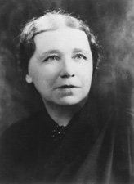
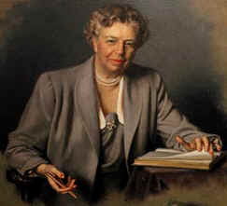
Prominent Women
Frances Perkins
first woman in a Presidential cabinet
Hattie Caraway
First woman elected to the US Senate
Eleanor Roosevelt
First Lady
FDR’s “eyes & ears”
Toured the country campaigning for women & minority rights

Slide 6
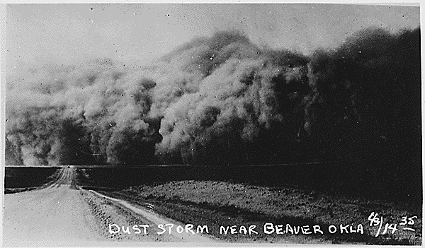
The Dust Bowl
New technologies such as tractors and plows cleared the land for crops
A drought in the 1930’s killed crops
Wind blew loose soil away
Lasted throughout the decade
Many farmers packed up and moved
About 400,000 moved to California to be migrant workers
So many were from Oklahoma they became known as Okies.

Slide 7
Plight of Minorities
African Americans, Native Americans, & Hispanic Americans were hit hard by the Depression
Already suffering from poverty the depression weakened the minority groups further

Slide 8
African Americans
The Bad
Unemployment in the south was over 50%
Many moved to northern cities but did not have much luck
Jobs were taken by whites who had lost their own
Continued to fight against prejudice
The Good
FDR appointed African Americans to federal posts
Had what was called the black cabinet
Robert Weaver
Ralph Bunche
Mary McLeod Bethune

Slide 9
Native Americans
Natives suffered from severe poverty
A new head of Bureau for Indian Affairs John Collier helped by starting Indian New Deal
Halted sale of native lands
Got 77,000 native jobs in the CCC
Obtained Public Works funds for schools
Got Congress to pass Indian Reorganization Act
Restored traditional tribal govt
Provided money for land purchases to enlarge reservations

Slide 10
Hispanic Americans
In the early 1930’s about 2 million Hispanic Americans lived in the US
Worked as migrant workers, farmers, laborers
When the Depression got worse people began resenting Hispanic Americans
Lost their jobs
People demanded they leave the US
The government encouraged Hispanic Americans to leave
Gave one way train tickets to Mexico
Deported them over the border

Slide 11
Radical Political Movements
Hard times helped radical political groups gain followers during the time
Socialists & Communists
Communism attracted workers, minorities, and intellectuals
Promised to end economic and racial injustice

Slide 12
Entertainment
Escapism: light or romantic, to help people forget the hard times
Social criticism: portraits of the hardships faced by people

Slide 13
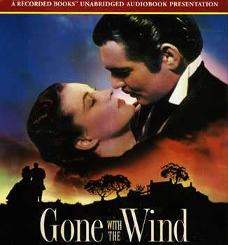
Radio & Movies
Radios became very popular in the 1930’s
Soap operas became popular
Comedians: George Burns
The Lone Ranger
FDR’s fireside chats
War of the Worlds – caused panic across the nation
About 85 million Americans went to the movies each week to escape troubles
Grapes of Wrath (1940)
Gone With The Wind (1939)

Slide 14
Images of the Times
Federal Arts Project under the WPA offered artists and writers the opportunity to work
Painters and writers captured the hardship of the Depression through words and art.
James Agee- Let us Now Praise Famous Men
Dorothea Lang, Margaret Bourke- took photos
Grant Wood, Thomas Hart Benton painted

Slide 15
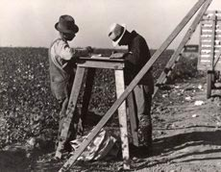
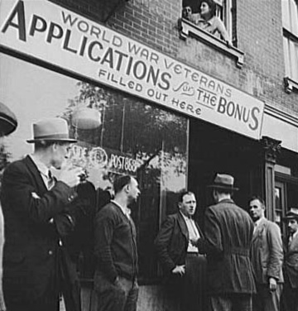
Dorothea Lang Photos

Slide 16
Literature of the 30’s
John Steinbeck’s : The Grapes of Wrath
Richard Wright – Native Son
Comics were also born in the 30’s
Flash Gordon
Superman
Dick Tracy

