Slide 1
JFK & LBJ

Slide 2
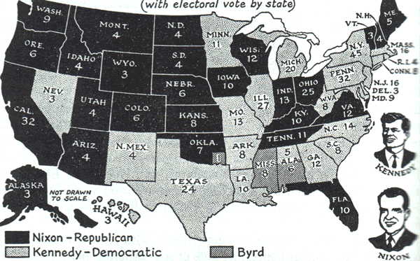
Election of 1960
Democratic Candidate : John F. Kennedy Jr.
Republican Candidate: Richard M. Nixon
Both were seasoned politicians, and war veterans
1960 marked the first televised campaigned coverage, and debates
Kennedy appealed to the public with his looks and his ease under pressure
Kennedy worked behind the scenes during the campaign to aid the NAACP and Martin Luther King Jr.
Earning the African American vote

Slide 3
Kennedy’s Cold War Strategy
Military build up
Conventional army funding
Missile projects
3rd world influence
Kennedy worked to provide aid to struggling nations
Peace Corps was established in 1961 to provide technical, educational, and health aid
Alliance for Progress was also established to provide economic help, but did not succeed

Slide 4
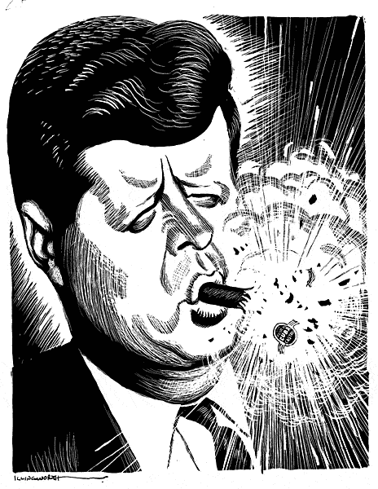
Bay Of Pigs
1959 Communism swept through Cuba, under the leadership of Fidel Castro
Castro nationalized lands held by US businesses
Began accepting economic and military aid from Soviet Union
Prior to Kennedy entering office Eisenhower had authorized the CIA to plan an overthrow of Castro
When Kennedy entered office he authorized the plan
April 1961 CIA and Cuban exiles attacked Cuba
The Attack was poorly carried out all but 300 were killed

Slide 5
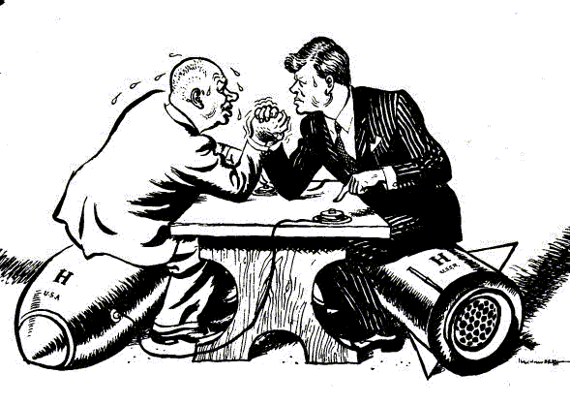
Cuban Missile Crisis
In 1962 the CIA discovered Soviet Missile bases being built on Cuba
Kennedy demanded the missiles be removed
He authorized a naval blockade of Cuban ports until his demands were met
Working behind the scenes to prevent a nuclear attack he negotiated with Khrushchev
Khrushchev agreed to remove the missiles if the US removed theirs from Italy and Turkey

Slide 6
Missile Crisis Fall Out
Kennedy was deemed a national hero, and much more mature than prior believed
Khrushchev lost favor in his country for backing down to the US
Both leaders wanted to move toward peace
Installed “hot line” between Moscow & Washington DC to improve communication
Signed the Nuclear Test Ban Treaty
No above ground testing of bombs

Slide 7
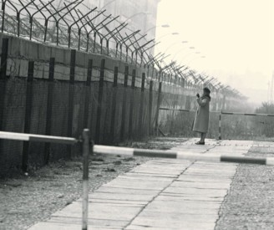
Berlin
At a conference in Vienna, Austria in June 1961 Kennedy and Khrushchev butted heads about Berlin
Khrushchev wanted all of Berlin brought under Soviet Control
Kennedy would not agree to Khrushchev’s demands
Following the conference Kennedy asked for increased military spending
Khrushchev had the Berlin wall built separating Eastern Berlin from Western Berlin

Slide 8
Domestic Programs
Disturbed by the number of people living in poverty Kennedy pushed through many social programs
Increase in minimum wage, extension in social security benefits, improved welfare system
Kennedy also was a champion for women’s issues
Passed the Equal Pay Act which gave women equal pay for equal work in industries engaged in commerce

Slide 9
Civil Rights Stance
Kennedy was timid on approaching Civil Rights issues
He did not have full support of Congress, and did not want to risk loosing his next election
In 1961, he protected Freedom Riders from certain peril
In 1963 he began legislation on a Civil Rights Bill

Slide 10
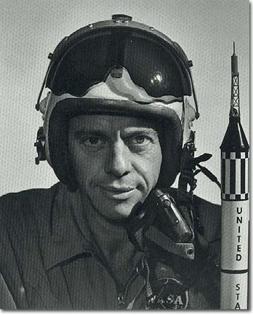
Space Race
Kennedy recognized the race between the US and the USSR
He continually funded NASA to close the gap between the two countries
Following Alan Shepard’s space flight, Kennedy promised the US would be on the moon by 1970
Neil Armstrong was the first man on the moon in 1969

Slide 11
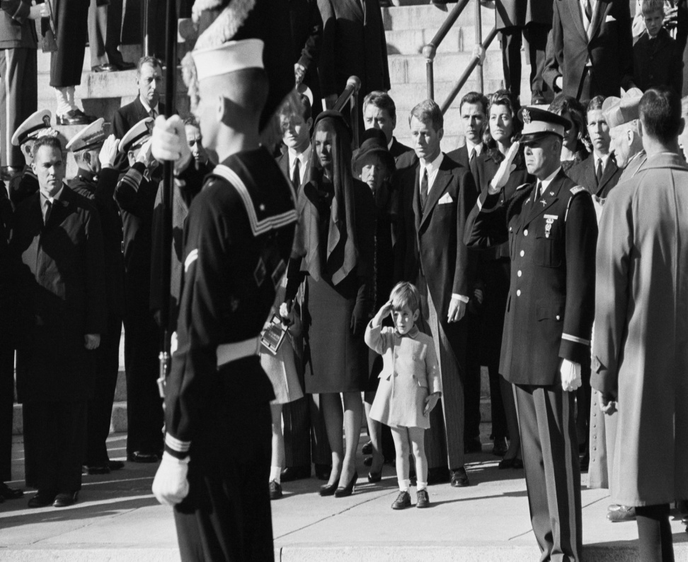
Kennedy’s Assassinated
In November 1963 JFK went to Dallas, TX to prepare for his 1964 campaigned
While riding in his motorcade he was shot and killed
Vice President Lynden B. Johnson was sworn in as President following the announcement of Kennedy’s death

Slide 12
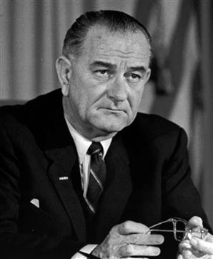
Lynden B. Johnson
Originally from Texas, LBJ had a strong political background and carried many of the same goals for America as JFK
Johnson pushed through bills begun by JFK including the Civil Rights Act of 1964
Johnson declared war on poverty
Cut taxes for middle-class Americans
Programs to train the jobless, educate the uneducated, health care reform
Economic Opportunity Act of 1964
Created Job Corp
VISTA-volunteers service to America
Head Start

Slide 13
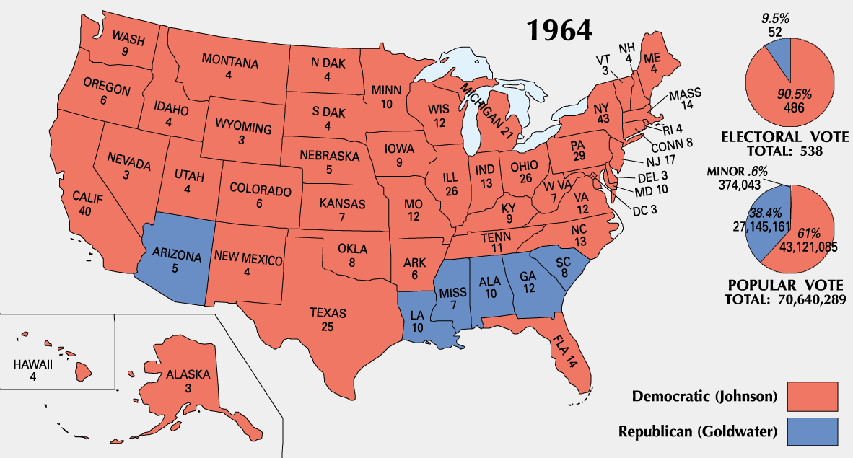
1964 Election
Following the completion of JFK’s term LBJ ran for President in 1964 on the Democratic Ticket
Berry Goldwater for the Republicans
Goldwater preached a smaller government, and opposed social welfare programs
With Kennedy’s legacy behind him and his success in aiding the country LBJ won in a landslide victory
Democrats also won both Senate and the House of Representatives that year

Slide 14
Johnson’s Great Society
Johnson wanted to end poverty, cure the sick, and give opportunity to every child
Health Care Reform
Added Medicare for elderly over 65 on Social Security
Added Medicaid for sick or disabled not part of Social Security
Education:
Johnson wanted to improve healthcare education in schools, funding was provided to give libraries, language labs, and learning centers to impoverished schools

Slide 15
Great Society Cont…
Environmental/ Consumer Protection:
Water Quality Act (1965) and Clean Water Restoration Act (1966) worked to improve and air quality
National Traffic and Motor Vehicle safety Act (1966) provided national safety standards for cars
Immigration:
Immigration and Nationality Act (1965) changed the quota system put into place in the 1920’s
Allowed people from Eastern Europe, Asia, Africa, and Latin America
Millions came from the 1960’s and 70’s

Slide 16
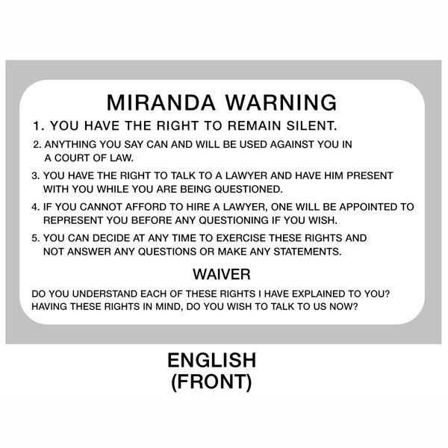
Supreme Court
Most Liberal in American History- led by Chief Justice Earl Warren
The court ruled in favor of civil rights, civil liberties, and personal privacy
Mapp v. Ohio the court ruled that evidence obtained illegally was against the 4th amendment and could not be used in trial
Gideon v. Wainwright decided accused criminals had the right to a lawyer whether they could pay or not
Escobedo v. Illinois Courts said accused criminals had to be offered a lawyer before questioning
Miranda v. Arizona ordered accused be given their 5th and 6th amendments before questioning

Slide 17
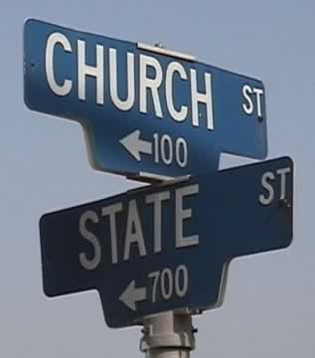
Separation of Church & State
The Warren Court ruled on Church and State affairs during 1960’s igniting a on going war
Engel V. Vitale ended with the court ruling that school prayer was in violation of 1st Amendment
Abington v. Schempp ruled that Bible reading in school violated the 1st Amendment
Many believed the decisions were hostile to religion, while others believed school was not a place to force religion

