Slide 1
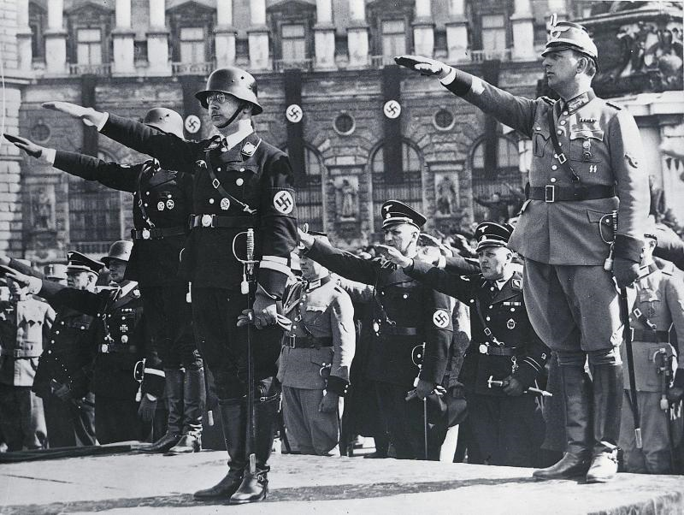
Foreshadowing of War

Slide 2
Resentment
Following WWI many nations resented the peace agreement & Treaty of Versailles
Italy thought they should have received more lands
Japan wanted more land and resources
Soviet Union was not invited to the peace talks
Germany was not invited to the peace talks and was blamed for the war and forced to pay retribution and cut their military

Slide 3
Totalitarian States
Soviet Union
Germany
Vladimir Lenin led a revolution in Russia creating a communist state leading to death, famine, starvation
Joseph Stalin took over after Lenin’s death, ruling with an iron fist. Used fear and propaganda to stay in power.
Adolf Hitler and the Nazi party took over Germany in 1933. Hitler censored the press, had secret police squash opposition, state run education programs, and he began rearming the country
Italy
Japan
Benito Mussolini formed the fascist party in Italy, and promoted nationalism and wanted to make Italy great again. Once in charge of the government he censored the press, had secret police, suppressed strikes, and formed youth groups
Military leaders took over and decided that Japan needed to expand its territory to obtain resources to bring them out of their Depression.

Slide 4
Adolf Hitler’s Rise to Power
Decorated WWI veteran
Joined the National Socialist German Workers Party (Nazi) following WWI and soon became its leader
Hitler’s party rose to popularity with its criticisms of the government and high unemployment rates of their country
They staged a revolution but failed and Hitler went to jail
In jail Hitler wrote Mein Kampf which outlined his plan for Germany’s success

Slide 5
Hitler Seizes Power
In 1933 the President of Germany appointed Hitler Chancellor of Germany
Within the next 2 years the President had died and Hitler had appointed himself President and Chancellor
By 1935 all evidence of Democratic rule had disappeared in Germany and Hitler ruled as a dictator

Slide 6
Hitler Repairs the Economy
Once in power Hitler began creating jobs for the German people
Public works projects were put into place to repair damage caused by WWI
Hitler began to rearm Germany against the conditions of the Treaty of Versailles
The Depression in Germany was over

Slide 7
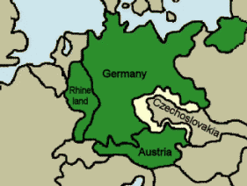
Hitler’s Aggressions
With the German Army, Navy, and Air force rebuilt Hitler began moving toward his goal to re-unify the Germanic peoples
In 1936 Hitler ordered the German Army to re-enter the Rhineland, and did so without answer from the League of Nations
1938 Hitler Annexed Austria without opposition
1938 Hitler also entered the Sudetenland to bring all German people together

Slide 8
Munich Pact
Many thought that Hitler’s Occupation of the Sudetenland would lead to war
Hitler, Neville Chamberlain, and Edouard Daladier met in Munich to discuss the situation and formed the Munich Pact
Chamberlain claimed that the pact “preserved peace for our time “ claimed that Germany and Britain would never go to war again.

Slide 9
Appeasement
Many nations were still haunted by the horrors of WWI and did not want to enter into a war of that scale again
Many believed a strong Germany would be a buffer zone between them and Communist Russia
Other nations were suffering from the Great Depression and could not involve themselves with foreign issues

Slide 10
Failure of League of Nations
The League of Nations never had the strength it needed when the United States did not join
Did not have a standing army
No power to enforce Decrees
Only as strong as its members , and with the Depression not many members could afford to get involved with large scale foreign events

Slide 11
Italy, Germany, & Spain
Spain was having a bloody Civil war from 1936-1939
Fascist leader General Francisco Franco was leading the movement against Spain’s democratic republican government
Hitler and Mussolini sent economic aid to Franco helping him against the government
The soviet union sent some aid to the democratic government, but received little help from France and Britain

Slide 12
Italy invades Ethiopia
Mussolini invaded Ethiopia in 1935, planning to create his own colonies and gain territory for Italy
The emperor of Ethiopia appealed to the League of Nations for support but received none.

Slide 13
Japan
In 1931 Japan began to expand its territorial holds
First they attacked Manchuria in northern China
Throughout the rest of the 1930’s Japan continued to expand throughout China brutally attacking its people and taking it’s resources
In 1937 Japan gained control of Nanjing the capitol city.
Japanese soldiers rapped and killed women and children
Beat, and murdered thousands of residents
Burned parts of the city
Known and the rape of Nanjing

Slide 14
The Coming of War
In 1939 Hitler broke the Munich Pact by annexing the remainder of Czechoslovakia
Britain and France realized he could not be stopped and signed an alliance with Poland vowing to protect her if invaded by Germany
Hitler was not worried about war with France and Britain, but wanted to prevent war with the Soviet Union, so he signed the Nazi-Soviet Nonaggression Pact which promised to split Poland between the two countries

Slide 15
The Breakout of War
September 1, 1939 Germany laid Blitzkrieg to Poland
On September 17, the Soviet Union invaded Poland from the East
Although Britain and France had declared war against Germany, Poland could not be saved
Poland fell to the Germans by the end of September.

