Slide 1
Ford/ Carter

Slide 2
Background
Star football player for Michigan State
Served during WWII in the US Navy
Ran for House of Representatives and served for 25 years
House Minority Leader
Vice President for Richard Nixon
Took over when Nixon Resigned

Slide 3
The Pardon
Upon entering office Ford tried to continue Foreign policy initiatives started by the Nixon administration
All support from the country was lost when Ford pardoned Nixon for his crimes
Mid-term elections reflected the countries distrust of Ford
Republicans lost 48 seats in the House

Slide 4
The Economy
The troubled economy under Nixon, became worse under Ford
Inflation hit double digits' between 1974 and 1975
Factories closed, and unemployment continued to rise
Despite Ford’s attempts to fix the economy he failed

Slide 5
Foreign Relations
The Ford Administration looked to maintain the working Détente they had with the USSR
Ford met with Lenoid Brezhnev twice during his presidency
Endorsed the Helsinki Accords
Putting Europe on record supporting Human Rights
The two leaders negotiated SALT II
Moved away from foreign intervention
Did not intervene in the genocide in Cambodia

Slide 6
1976 Election
Ford- Republican Ticket
Jimmy Carter- Democratic Ticket
Georgia
One time politician (Governor of Georgia)
Born again Christian
Carter ran on the notion that he was a fresh face, and received votes from untrusting Americans and the Fundamental Christian Vote

Slide 7
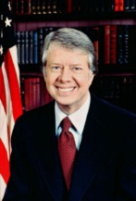
Jimmy Carter

Slide 8
Inexperience
The inexperience that got Carter elected hurt his success as President
Submitted several bills to Congress, but few passed without considerable changes
Gave amnesty to Vietnam draft evaders, which caused a rift in the nation
Limited ties with prominent people in Washington

Slide 9
Energy Crisis
The economy remained bad, with high unemployment and inflation
Chrysler requested federal loans to stay open
Competition from Japanese auto makers hurt the nation
Prices of fuel continued to rise as the country faced a shortage of fuel
The nation blamed the administration and its inexperience for not fixing the energy crisis

Slide 10
Carter Foreign Policy
Carter continued working on SALT II upon entering office and submitted it to the Senate
The senate debated bitterly on it’s ability to protect the nation
USSR invaded Afghanistan in 1979 causing Carter to withdraw SALT II from the Senate
Cut off US grain shipments to USSR
US boycotted the Olympic games held in Moscow

Slide 11
Carter and Castro
Carter’s administration tried to smooth ties with Cuba
Fidel Castro announced that Cubans wishing to leave the country could leave on boat, but would have to carry Cuban prisoners with them
Americans were appalled by the lack of concern for the emigrants safety and they were sending criminals to our country

Slide 12
Carter and Panama
Carter raised further concern with the nation when he negotiated the return of the Panama Canal to Panama
Carter worked out agreements that the canal would be returned to Panama Government in 1999
Americans feared that it would affect American trade and shipping

Slide 13
Israel vs. Egypt
Israel and Egypt had been fighting a war since Israel's creation in 1948.
Eager to seek peace the two nations met at Camp David to reach an agreement
The Camp David Accords:
Egypt recognized the existence of Israel as a nation
Israel removed troops from Egypt

Slide 14
Iran
In 1979 the ailing Shah of Iran fled Iran due to Cancer and opposition
Ayatollah Khomeini a fundamentalist Islamic group rose to power opposing the Shah
Iranian radicals invaded the US Embassy in Iran and took 66 US citizens hostage
The Ayatollah Khomeini took control of the embassy and hostages to defy the US

Slide 15
Hostages
Of the initial 66 hostages taken only 52 were held
Carter tried tirelessly to free the hostages from Iran
Imposed an economic embargo on Iran
Unsuccessful military actions
Carter was never able to successfully free the hostages
They were released after 444 days of captivity when Ronald Regan was inaugurated President

Slide 16
Ronald Reagan

Slide 17
1980 Election
Although Reagan did not have much political experience to take the White House, the Conservatives were gaining strength and ushered him in
He won 489 Electoral Votes to Carter’s 49
He asked the people “are you better than you were 4 years ago?”
Played on the Soviet invasion of Afghanistan
Discussed Inflation
The Iran Crisis
Small Government demands
Overall gifts of public speaking

Slide 18
Reaganomics
Reagan's administration focused on supply-side economics
Reduce taxes-→people will work more → have more $ →spend more $→economy will grow → providing more tax money from sales
Congress backed Reaganomics
Passed Economic Recovery Act of 1981
Reduced taxes by 25% over 3yrs
Deregulated businesses
Cut funding for government agencies in social and regulation programs

Slide 19
Budget Crisis
During the early years of Reagan’s term the economy suffered a recession causing many of America’s poor to lose their homes and farms
America’s richer got richer though
The nation also suffered a budget deficit
The money spent was more than the money taken in and continued to grow
$79 billion in 1981- $221 Billion in 1986 (national debt was $2.5 Trillion)
Savings and Loan Crisis
1,000 banks failed during the late 1980’s
Federal government spent $200 Billion bailing them out

Slide 20
Conservative Strength Continues
Reagan won re-election in 1984 despite budget issues and world affairs
He nominated 3 conservative supreme court justices
Sandra Day O’Connor, Anthony Kennedy, Antonin Scalia
Meant to move away from liberal court decisions
Passed the Equal Access Act
Required all schools to provide equal access to school facilities

Slide 21
US Military
Largest Peace Time buildup in peace time history
Spent billions on b-1 and b-2 bombers
Placed new nuclear missile launch sites in Europe
Began the Strategic Defense Initiative
Star Wars
Lasers from space and land would shoot down enemy missiles threatening US

Slide 22
Anti-Communist Aid
Regan believed that funding anti-communists around the globe would bring down communism
CIA trained/funded mujahedeen rebels in Afghanistan to fight soviet troops
US funded Nicaraguan rebels to protect the nation from Communism
El Salvador, and Grenada were also funded and protected

Slide 23
Gorbachev
Mikhail Gorbachev became President of USSR in 1985 he brought new ideas of leadership
Glasnost- “a new openness”
Perestroika- reforming the soviet system
USSR economy was in ruin
Food shortages, factories could not compete, military drained funding
Attempted to bring USSR away from socialist controlled government

Slide 24
Reagan Meets Gorbachev
Reagan met with Gorbachev 4 times during his second term in office
Reagan announced that the USSR was no longer an evil empire, that era had passed
START I Treaty was negotiated
Limiting the number of nuclear weapons in the world

Slide 25
Iran-Contra Affair
In 1985 the US government sold weapons to Iran in exchange for their promise to pressure Lebanon to release American hostages
The plan did not work (made US look bad for going against their “no negotiation with terrorist agreement”
The money from the weapons sales was sent to Nicaragua Contra fighters despite Congress’s ruling that no more funds would be sent to Nicaragua
In 1986 news of this came out and those involved were convicted and sent to jail

Slide 26
The War Ends
From 1988-1991 many coups spread across Eastern Europe collapsing Communist governments
Poland, Hungary, Czechoslovakia, Bulgaria, Romania, Albania, and Yugoslavia
These countries held Democratic elections
The Berlin Wall fell allowing Western Germans to mingle with Eastern Germans for the first time in years

Slide 27
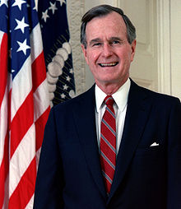
George H.W. Bush

Slide 28
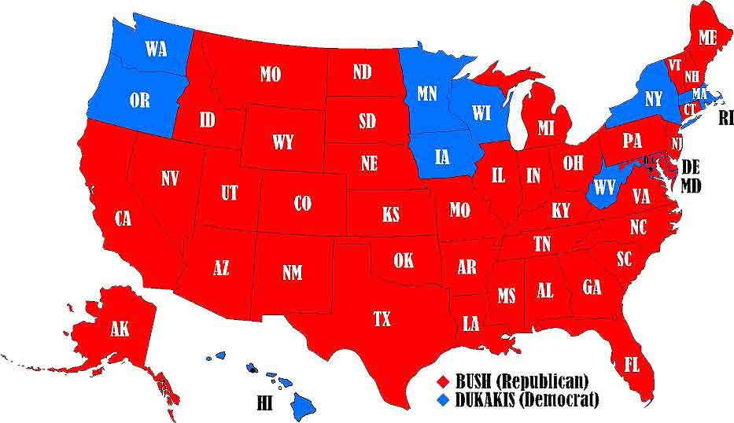
1988 Election
Reagan used his lasting popularity to promote George H.W Bush to win the Republican nomination in the 1988 Election
Bush campaigned against Democrat Michael Dukakis
Supported conservatives
Promised not to raise taxes
Bush won, but democrats controlled the house and the senate

Slide 29
Foreign Policy
The United States was “waging the war on drugs” against Latin America
Bush sent 12,000 US troops to Panama and arrested their Dictator and tried him for drug trafficking (he served 40 years)
Arrested Numerous drug lords and users to clean up the streets

Slide 30
Foreign Policy Cont
In China, Students picketed in the streets to end communism in 1989
Chinese government sent in tanks to Tiananmen Square, killing hundreds, and imprisoned hundreds more
Bush condemned the actions of the Chinese government and stopped arms sales to China

Slide 31
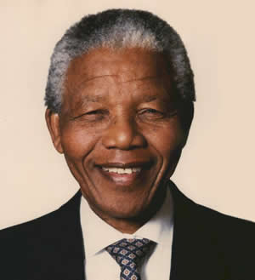
The End of Apartheid
South Africa, long run by Apartheid began to move toward change
Nelson Mandela was released from jail in 1990 (imprisoned since 1962)
American Businesses and Congress placed economic sanctions on South Africa until it stopped Apartheid
Bush encouraged Mandela to push toward Democracy
1994 Mandela was elected as President in the first democratic free election

Slide 32
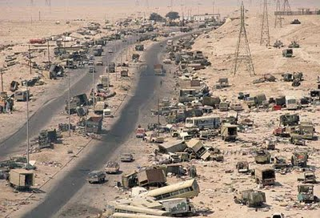
The Persian Gulf
August 2, 1990 Iraq invaded Kuwait and quickly defeated the Kuwait army
President Bush, feared that the Iraqi leader, Saddam Hussein, would gain control of Kuwait oil fields and use his control of oil to harm the world
Bush put together a UN resolution demanding Iraq to leave Kuwait

Slide 33
Operation Desert Storm
By Fall of 1990, Bush had placed 500,000 American troops who were joined by 200,000 international forces in Saudi Arabia
Economic sanctions were placed on Iraq
Bush had permission from Congress to use force if necessary
General Colin Powell & General Norman Schwarzkopf devised a plan to attack from the air
For 5 weeks Iraq was bombarded with bombs
Iraqi troops fled Kuwait when US and international forces entered the country

Slide 34
Peace Keeping Missions
Bush sent Marines into Somalia in the winter of 1992 in order to negotiate peace between warlords
Delivered food to the starving
The mission was a success for the Bush Administration
Bush backed a small UN mission to aid people in Bosnia caught up in the bloody civil war

