Slide 1
Civil Rights Movement

Slide 2
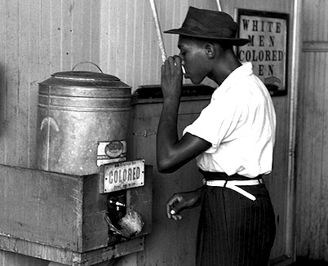
Jim Crow
Despite Constitutional Amendments 13-15 African Americans did not experience the same treatment as whites
Segregated schools, hospitals, restaurants, water fountains, parks, etc were the norm through the US.
Supreme Court Case Plessy vs. Ferguson 1896 allowed separate but equal
Segregation was not limited to the south, the north also limited African Americans and other minorities

Slide 3
CORE
Efforts made by Mohandas Gandhi and Henry David Thoreau lead many African Americans to use non violent methods of protests to earn their Civil Rights
The Congress of Racial Equality (CORE) was established in the 1940’s to organize protests against segregation
The first break in segregation was when Jackie Robinson played for the Brooklyn Dodgers in 1947.
Truman Desegregated the military in 1948

Slide 4
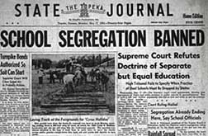
Brown vs. Board of Education
NAACP was the most powerful civil rights organization in the country during the late 1940’s and 50’s.
Thurgood Marshall, an African American lawyer began taking cases of segregation to the supreme court and winning
The biggest case, Brown vs. Board of Education in 1954
Ordering the Desegregation of public schools

Slide 5
Reaction to Brown
Southerners were outraged by the decision of the Supreme Court
Southern politicians signed “The Southern Manifesto” pledging to oppose the decision through all lawful means
The KKK resurged

Slide 6
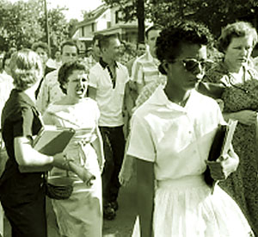
Federal vs. State
Little Rock Arkansas was the most famous for the integration of schools
9 African Americans were chosen to enter an all white public school in 1957
The governor of Arkansas ordered the National Guard to prevent the students from Entering
President Eisenhower was determined to enforce the will of the courts
He ordered Federal troops to Little Rock
The troops watched over the African American students throughout the school year

Slide 7
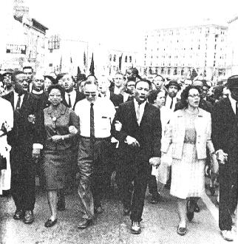
Montgomery Bus Boycott
1955, Rosa Parks refused to give up her seat on a bus to a white person
She was arrested for this act
Parks’ arrest led to the African American community to boycott the busses for 1 day
On the evening of the boycott Martin Luther King Jr. gave a moving speech which led to a one year boycott of the busses
In 1956 the Supreme Court ruled the Montgomery city law was unconstitutional

Slide 8
Civil Rights Act of 1957
The Civil Rights Act of 1957 was passed in order to protect the civil rights of Americans
Established the United States Civil Rights commission
Investigate violations against Civil Rights
US Attorney General received greater power to protect the voting rights of African Americans

Slide 9
SCLC
The bus boycott led African Americans to believe they did have power over their future
Martin Luther King and Ralph Abernathy established the Southern Christian Leadership Conference (SCLC) to promote non violent protests
Prayer pilgrimage

Slide 10
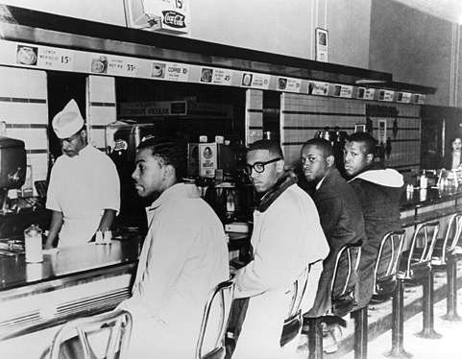
Sit-Ins
February 1, 1960 four African American college students went into a Greensboro, NC diner and sat at the white only lunch counter
This act led to Sit-ins, read-ins, wade-ins, etc
The people who took part in this were trained to ignore name calling, and violence against them
Groups such as the Student Nonviolent Coordinating Committee was established to organize protests

Slide 11
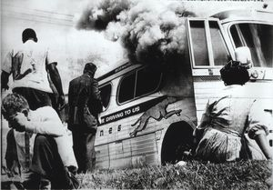
Freedom Riders
CORE members decided to ride a bus from Washington DC to New Orleans
In Alabama they were attacked
One was firebombed
The riders of the second bus were attacked
President Kennedy worked with Mississippi to protect the riders
He arranged the desegregation of Interstate transportation in exchange he agreed not to intervene with the arrest of Freedom Riders for disturbing the peace

Slide 12
Protests Intensify
James Meredith wanted to attend Ole’ Miss University and fought with Medgar Evers a Civil Rights worker to get in
Upon entrance into the university a riot erupted
160 people injured 2 dead
Within 5 years of graduation Meredith and Evers were both assassinated for their Civil Rights efforts

Slide 13
Birmingham
In 1963, MLK and the SCLC focused to target segregation in Birmingham, AL
Most segregated city in the south
Court Officials got a court order banning demonstrations in the city
MLK broke this order and was sent to jail
Upon MLK’s release they increased their demonstrations
Police dogs, fire hoses were used on the protesters
Americans were shocked by the force used, and sent thousands of letters to the White House demanding the President act.

Slide 14
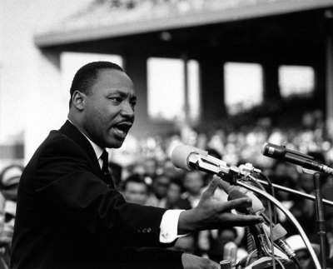
March on Washington
August 1963 more than 200,000 protestors for the Civil Rights movement marched on Washington
The movement was peaceful and many popular performers entertained the crowd.
MLK addressed the group and the nation via TV
His “I Have a Dream” led the country to realize that civil rights needed to be addressed

Slide 15
Civil Rights Act of 1964
President Kennedy had initiated a wave of civil rights legislation in 1963 and was backed by Attorney General Robert F. Kennedy
Following the March on Washington Congress passed the Civil Rights Act of 1964
Banned segregation in public accommodations
Federal government had the power to compel state and local schools to desegregate
Justice department had the right to prosecute those who violate others civil rights
Outlawed discrimination in employment by race, sex, or national origin
Established the Employment Opportunity Commission

Slide 16
Voting
Despite the Civil Rights Acts, none of them addressed voting rights
The south used literacy tests, poll taxes, and violence to prevent blacks from voting
SNCC organized Freedom Summer in 1964
Over 1,000 African American and white students worked to register blacks to vote
At the beginning of the movement 3 volunteers were reported missing, later found murdered and buried in shallow graves

Slide 17
Selma
In 1965 MLK and the SCLC marched on Selma, AL to address voter rights
Several confrontations between state police and protestor took place (Bloody Sunday)
President Johnson addressed the nation regarding voter laws in reaction to Selma
Congress passed the Voting Rights Act of 1965 and elections
Banned literacy tests, and empowered federal government to oversee voting registration
24th Amendment
Banned poll taxes

Slide 18
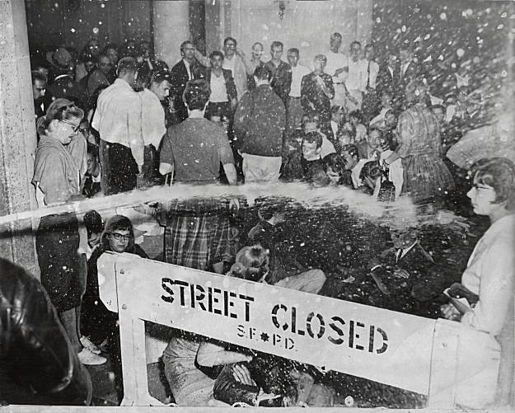
Racial Violence
Race Riots erupted in the later part of the 1960’s
African Americans were rioting against White business owners and police
In Detroit 43 people died in a riot and $50 million in property damage
President Johnson organized the Kerner Commission to investigate the cause of the riots
Concluded that longer racial discrimination was the main cause
Recommended expanding federal spending to help African Americans overcome problems in ghettos

Slide 19
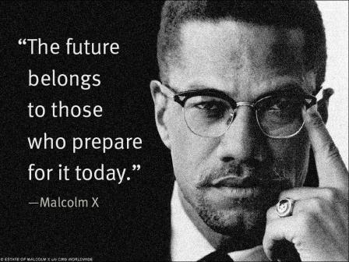
Malcolm X
Besides Non-violent protesters the Civil Rights movement had Radicals
Malcolm X had a difficult childhood and became involved in crime and drugs, which landed him in jail
While in Jail he converted to Islam, which led him to become a radical speaker for African American Rights
Malcolm X was assassinated in 1965

Slide 20
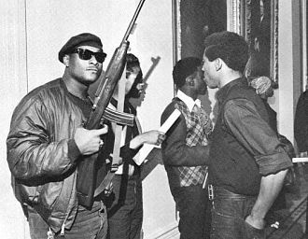
Black Panthers
SNCC members began questioning non-violent protest during the later 1960’s
Stokely Carmichael an SNCC member demanded the need for “Black Power” meaning they should merge economic and political power to gain equality
The Black Power speech led Huey Newton and Bobby Seale to form the Black Panthers
Organized armed patrols of urban neighborhoods
Created antipoverty programs
Marched on Sacramento with shotguns

Slide 21
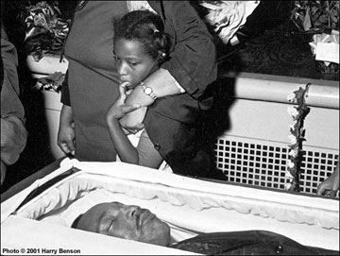
MLK Assassinated
MLK disagreed with Black Power and the Black Panthers he believed the non-violent method was best
While working in Tennessee working on his “Poor People’s Campaign” he was shot and killed
Riots broke out in hundreds of cities
Millions mourned MLK’s death

Slide 22
Significant Gains and Controversial Issues
Gains:
Issues
Eliminated legal segregation
Desegregated the schools
Aided African American voting rights
African American poverty rates fell
Graduation rates increased
Thurgood Marshall became first African American Supreme Court Justice
Fair Housing Act was passed banning discrimination in housing
Forced Busing
Affirmative action

