Slide 1
America and the War

Slide 2
Isolationism
FDR feared that Hitler’s aggressions would not stop in Europe
The majority of Americans opposed US intervention in the war
Many American’s believed that the sacrifices made in WWI were nullified by the onset of Fascism
Many suggested that business men and bankers brought the US into the war to make $ by selling weapons and supplies

Slide 3
Neutrality Acts
Congress passed Neutrality Acts of 1935,1936, & 1937
  Americans were prohibited from sailing on ships owned by nations at war
  Americans were prohibited from giving loans to nations at war
  Also prohibited from selling Arms or munitions to them
Neutrality Act of 1939
  Allowed nations at war to buy weapons in the US as long as they paid cash and carried them on their own ships

Slide 4
The Great Debate
Isolationists and interventionists argued about whether or not the Neutrality Act of 1939 violated American Neutrality
Interventionists claimed that by aiding Britain we were helping defend free countries everywhere
Isolationists said that by helping Britain we were helping hurt the Axis which would eventually bring us into war.

Slide 5
Roosevelt’s Involvement
Following news reports from London, many American’s believed they needed to prepare to defend themselves
In 1940 Germany, Italy, and Japan signed the Tripartite Pact which made them formal allies
The same month the Selective Service Act was passed
  Peace time draft which trained 1.2 million soldiers and 800,000 reservists

Slide 6
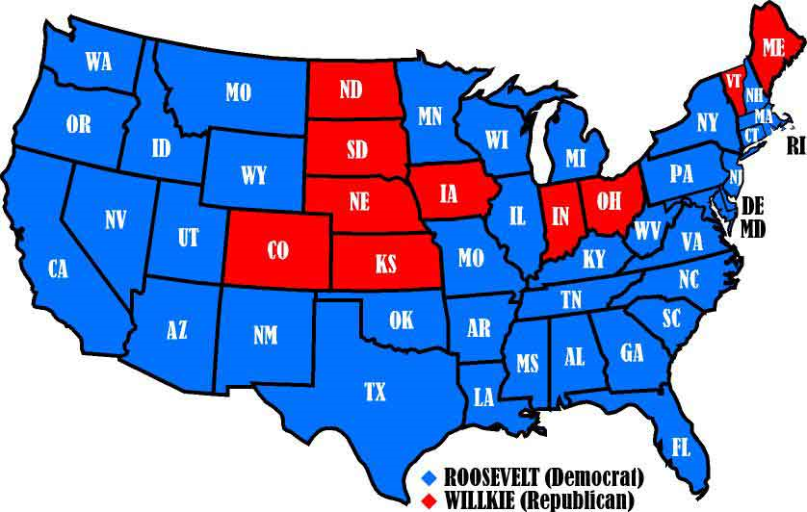
A Third Term
In 1940 America’ was facing a crisis and a presidential election
Roosevelt ran for an unprecedented 3rd term
Wendell L. Wilkie of Indiana was his opponent
  Critical of Roosevelt's handling of the economy and foreign affairs
American’s choose to stay with Roosevelt, who won overwhelmingly across the nation

Slide 7
Steps Toward War
Once re-elected Roosevelt increased his backing of Britain
When Britain ran out of funds for cash-n-carry he persuaded Congress to pass the Lend-Lease Act
  Authorized the president to sell, transfer, exchange, lease, or dispose of any government defense item.
  By 1945 the US had given the Allies more than $40 billion of Lend-Lease aid

Slide 8
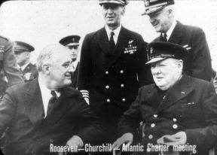
Atlantic Charter
In August 1941 Churchill and FDR met on a warship off the coast of Newfoundland
  Signed the Atlantic charter which endorsed self-determination, and international system of general security
  Signaled a deeper alliance between the US and Britain
Hitler ordered the attack of US ships, in order to prevent transfer of goods to Britain. (June 1941)
  Although the US was still neutral FDR ordered the navy to attack German U-boats on sight

Slide 9
Embargo on Japan
Japan’s empire continued to grow in China throughout the 1930’s, then they began moving into Indo-China
Following Japan’s alliance with Germany and Italy FDR placed a resource embargo on Japan
  Iron ore, oil, steel, fuel, rubber
The US and Japan continued throughout 1941 to negotiate an end to the embargo, but could not reach an agreement

Slide 10
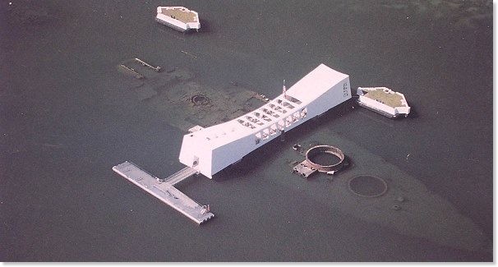
December 7, 1941
As negotiations were still going on the Japanese navy sailed toward Pearl Harbor, HI
Their mission was to crush the American Pacific fleet
In the aftermath of the attack which happened very quickly
  2,500 were killed
  8 battleships severely damaged (Arizona, Utah, Oklahoma)
  3 destroyers lost
  3 cruisers damaged
  160 airplanes lost
  128 airplanes damaged

Slide 11
American Declares War
The attack on Pearl Harbor ended any debate between interventionists and Isolationists
Following FDR’s request to go to war, Congress and the Senate voted unanimously to go to war
Japan, Germany, and Italy declared war on the US following America’s declaration of war on Japan.

Slide 12
Patriotism
Following Pearl Harbor nationalism and patriotism spread
  The army expanded from 1.4 million to 3 million from 1941-1942
  The navy went from 300,000-600,000
  Mexican Americans, Native Americans, and African Americans joined the ranks as welll
  350,000 women joined and congresswoman Edith Nourse Rogers introduced a bill creating the Women’s army corp.

Slide 13
Industry
January 1942 the government set up the War Production Board (WPB) to oversee the conversion from peacetime industry to wartime
  Ford Motor Company put all its resources into war production ( built over 8,000 B-24 bombers)
The massive defense spending ended the Great Depression
  There was a job for every worker

Slide 14
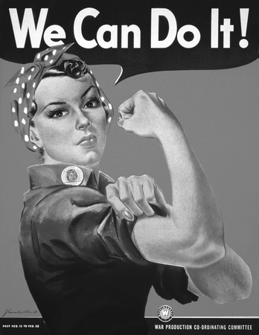
Women in the Workforce
Women took jobs during the War to help in the production of war materials
  Many women worked on airplanes, munitions, guns, etc
Women were often expected to go home following the war, but many stayed on in their jobs and changed trends of women employment.
Rosie the Riveter was an icon for women in the workplace

Slide 15
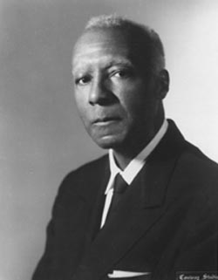
African Americans
African Americans continued to face discrimination during the war
  Segregated units
  Unfair hiring practices for government jobs
A Phillip Randolph demanded Roosevelt address civil rights of African Americans
  FDR passed the Executive Order 8802
    Assured fair hiring practices in any job funded by the government

Slide 16
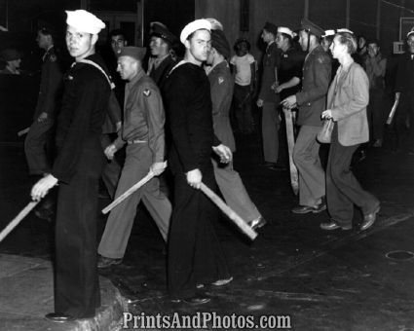
Population Shifts
As industrial cities boomed with work during the war people were moving from rural areas to urban work settings
  California gained 2 million residents looking for work in ship yards
  Chicago, Detroit, and New York also saw a rise in population
Discrimination loomed within these cities, and African American’s and Mexican American’s faced the brunt of it
  Detroit a riot broke out between whites and African Americans leaving 34 dead
  San Diego white naval sailors attacked Mexican Americans in the Zoot Suit Riots

Slide 17
Germans, Italians, and Japanese
American’s were on high alert regarding immigration of Germans, Italians, and Japanese
If any were thought to be dangerous to national security they were deported
  11,000 Germans and hundreds of Italians were held in camps
  In 1942 they were forced to vacate the West Coast

Slide 18
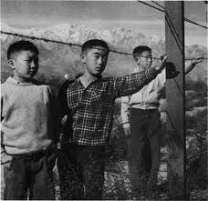
Internment
The orders for Germans and Italians were lifted, the Japanese immigrants and Japanese Americans received no such treatment
Executive Order 9066
  Evacuated 100,000 Japanese Americans on the West Coast
  Forced to sell property, allowed only necessary items
Men, women, and children were taken to camps in Arizona and imprisoned until the wars end

Slide 19
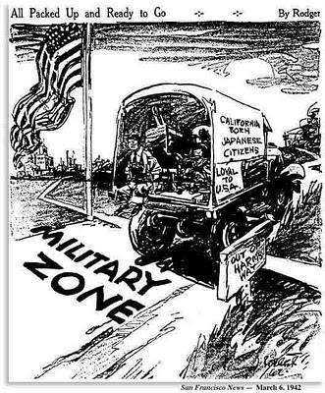
Supreme Court
Many Japanese American’s sued for their rights and civil liberties
  Korematsu v. United States upheld FDR’s decision (however in 1988 the government issued an apology and $20,000 in payments)

Slide 20
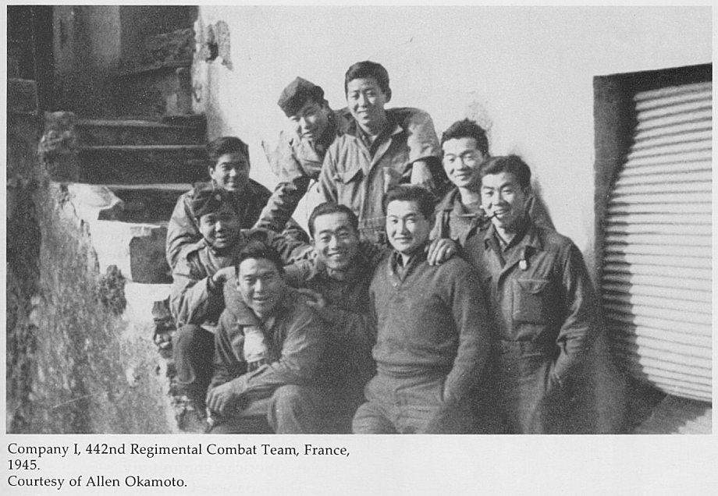
Japanese American Soldiers
Until 1943 Japanese Americans were not allowed to enlist in the armed forces
Due to a need for battle ready soldiers the US lifted that ban
The 442nd Regiment Combat Team (all Japanese Americans) fought bravely in the Italian campaign
  They are the most decorated military unit in American History

Slide 21
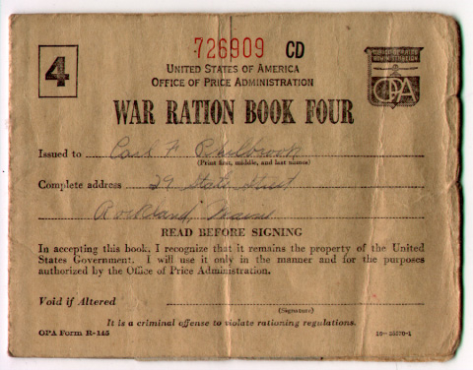
Supporting the War Effort
Rationing:
  Americans were given coupon books that limited their purchase of certain goods
War Bonds:
  American’s invested in war bonds to save income
  Encouraged by the government “every dollar spent on a bond meant another bullet and another step closer to victory”

Slide 22
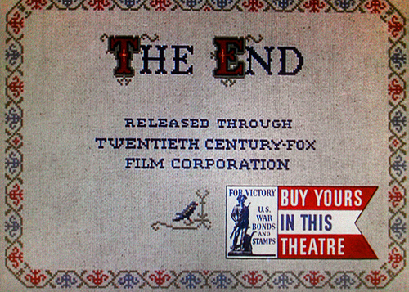
Hollywood
The Federal Office of War Information (OWI) worked with Hollywood to keep people focused on the war
Frank Capra’s Why we Fight
  Reminded Americans that they were fighting between dictatorship and democracy
Movie stars volunteered their time to sell war bonds
Planted victory gardens
Collected scrap metal and paper

